Slide 1
Getting Started with Machine Learning
Session 1: What is Machine Learning?
Notes:
Facilitator doc

Slide 2
Session Outline
1
2
3
What is Machine Learning (ML)?
What is the difference between ML and traditional programming?
What challenges can ML be applied to?

Slide 3

Brainstorm
List the ways you use a computer* each day.
* Laptop, phone, tablet, etc.
Notes:
Say to the students, "With the person seated next to you, brainstorm a list of ways you use computers"
After this brainstorming is complete, have students raise their hands to share the list of tasks they created.
Write these as a list on the whiteboard or keep track of them somehow, as you will refer to them at the end of the session.

Slide 4
Traditional Programming vs.
Machine Learning

Slide 5


What food am I thinking of?
How many questions would you need?
Notes:
Say to the students, "Imagine I am thinking of a particular food. With the person seated next to you, brainstorm a list of questions you might ask to determine what food it is based on its physical attributes such as size, color, shape."
After this brainstorming is complete, have students raise their hands to share the questions they might ask.
Ask students to think and share a prediction of how many questions they would need to feel confident they would be able to determine the right food every time.
Image is Public Domain

Slide 6
What object am I thinking of?
How many questions would you need?
Notes:
Ask students to consider how many questions they might need if they were trying to classify not just food but any object.
Facilitator note: While information theory says no more than 20 questions is needed, the number of potential questions would exponentially increase. This presents a problem for traditional programming seen in the next slide.
Image is Public Domain

Slide 7
Traditional Programming
if object.height > 10:
do x
if object.color is blue:
do y
if object.numberOfLegs > 2:
do z
...
System only does what it was programmed to do
Notes:
Say to the students, "Creating instructions is how many people develop software and it is the most common method used. As you can see this method could be difficult when there are lots of possibilities. It's also important to point out that the system only does what it was programmed to do so it can be difficult to anticipate what to do in new situations.
In the previous activity, you came up with a series of questions to help you figure out what food I was thinking of. Those questions became inadequate as soon as we broadened the possibilities to any object."

Slide 8





Machine Learning
Collect Data
Predict
Focus on User
Define Objective
Train and Test Model
System learns patterns from data
Notes:
Say to the students, "A complementary approach when developing software is Machine Learning. This is a system which learns from data rather than being explicitly programmed to via a rule".
Machine learning includes the following steps
Focus on the user - Machine learning, like any other type of software development approach requires you know who you are designing for.
Define the objective - Machine learning cannot tell you what to do with the data, the system can only do what it's been designed to do. You'll need to decide what your objective is and how you'll measure it.
Collect data - It's been said that if Machine Learning is a rocket then data is the fuel. In order for the system to learn from examples, you'll need data.
Train and test model - The system is going to look at the data and attempt to come up with a way to meet the objective set in the 2nd step. This could be a decision tree, an equation, or some other pattern learned from the data.
Predict - The system applies the model to new data and makes a prediction based on previous examples. The programmer then measures how well it met the objective and continues to refine the system over time.

Slide 9
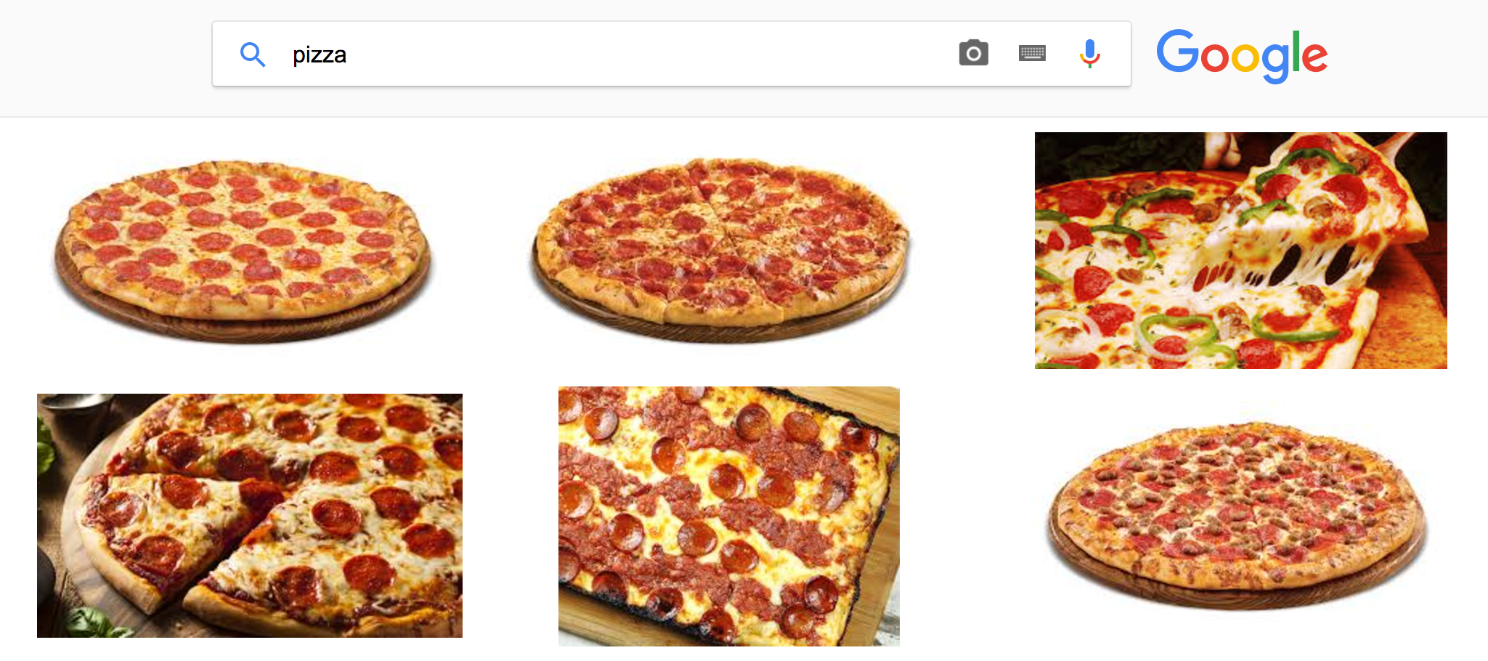
Example: Image Search
Google Image Search
Notes:
Classification Example 1: Demonstrate how Google Search is able to display similar images
Open a web browser from the computer that is projecting the screen and navigate to Google Image Search at https://www.google.ae/imghp
Search for [Pizza]

Slide 10
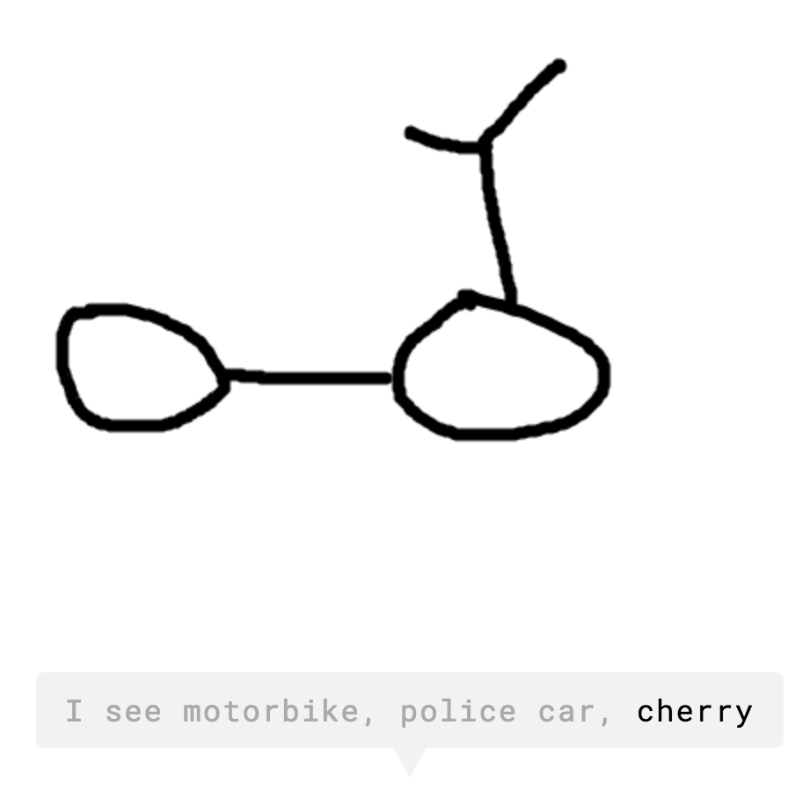
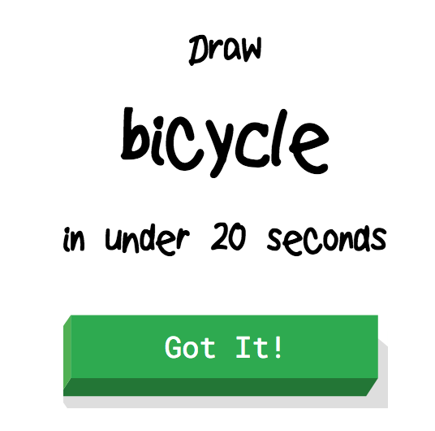
Example: Drawing
Quick Draw with Google
Notes:
Classification Example 2: Students experience a computer classifying a drawing (5 - 10 minutes)
Navigate the browser to the Quickdraw web application http://quickdraw.withgoogle.com/
Option 1 - If enough technology is available, pair students and let them try it out
Option 2 - Display the website from the projector
Say to the students, "for each of these examples the computer has classified objects. In the first, the computer is able to classify which images are pizza and in the second, the computer determines what type of object from a drawing"
Ask the students to recall the earlier exercise about the mystery food. Remind them the challenge of doing this via a list of rules because the number of rules increases with the number of possibilities.

Slide 11

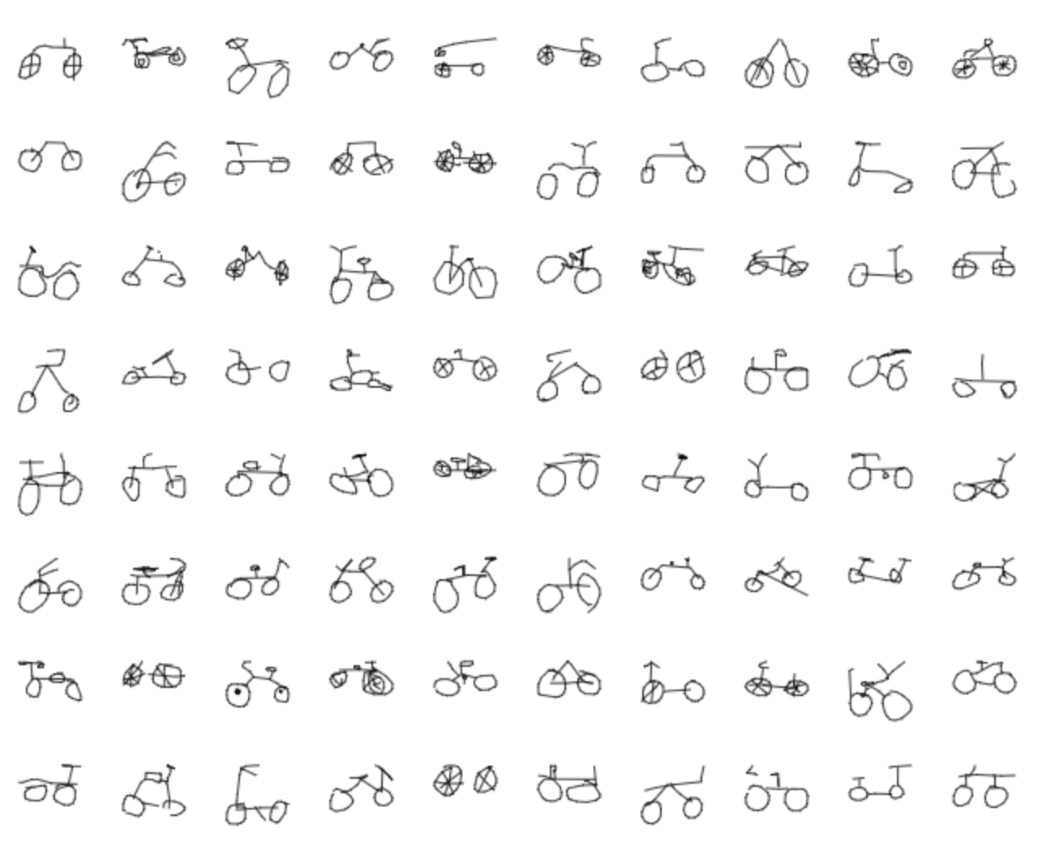
Example: Drawing (Data)
Quick Draw with Google Data
122,500 bicycle drawings
Notes:
Show the students examples from the data from Quickdraw.
Option 1 - Show the slide with some data for bicycles
Option 2 - Open https://quickdraw.withgoogle.com/data to see more of the data
Say to the students, "It would be very difficult if not impossible to create instructions that would cover all of the possible ways to identify pizza or ways to draw an object so machine learning gains this understanding from examples. For the Quick Draw example, the machine was trained to thousands of bicycle drawings where it learned characteristics of lines that can be used to represent a bicycle and it can do that with lots of other objects"

Slide 12
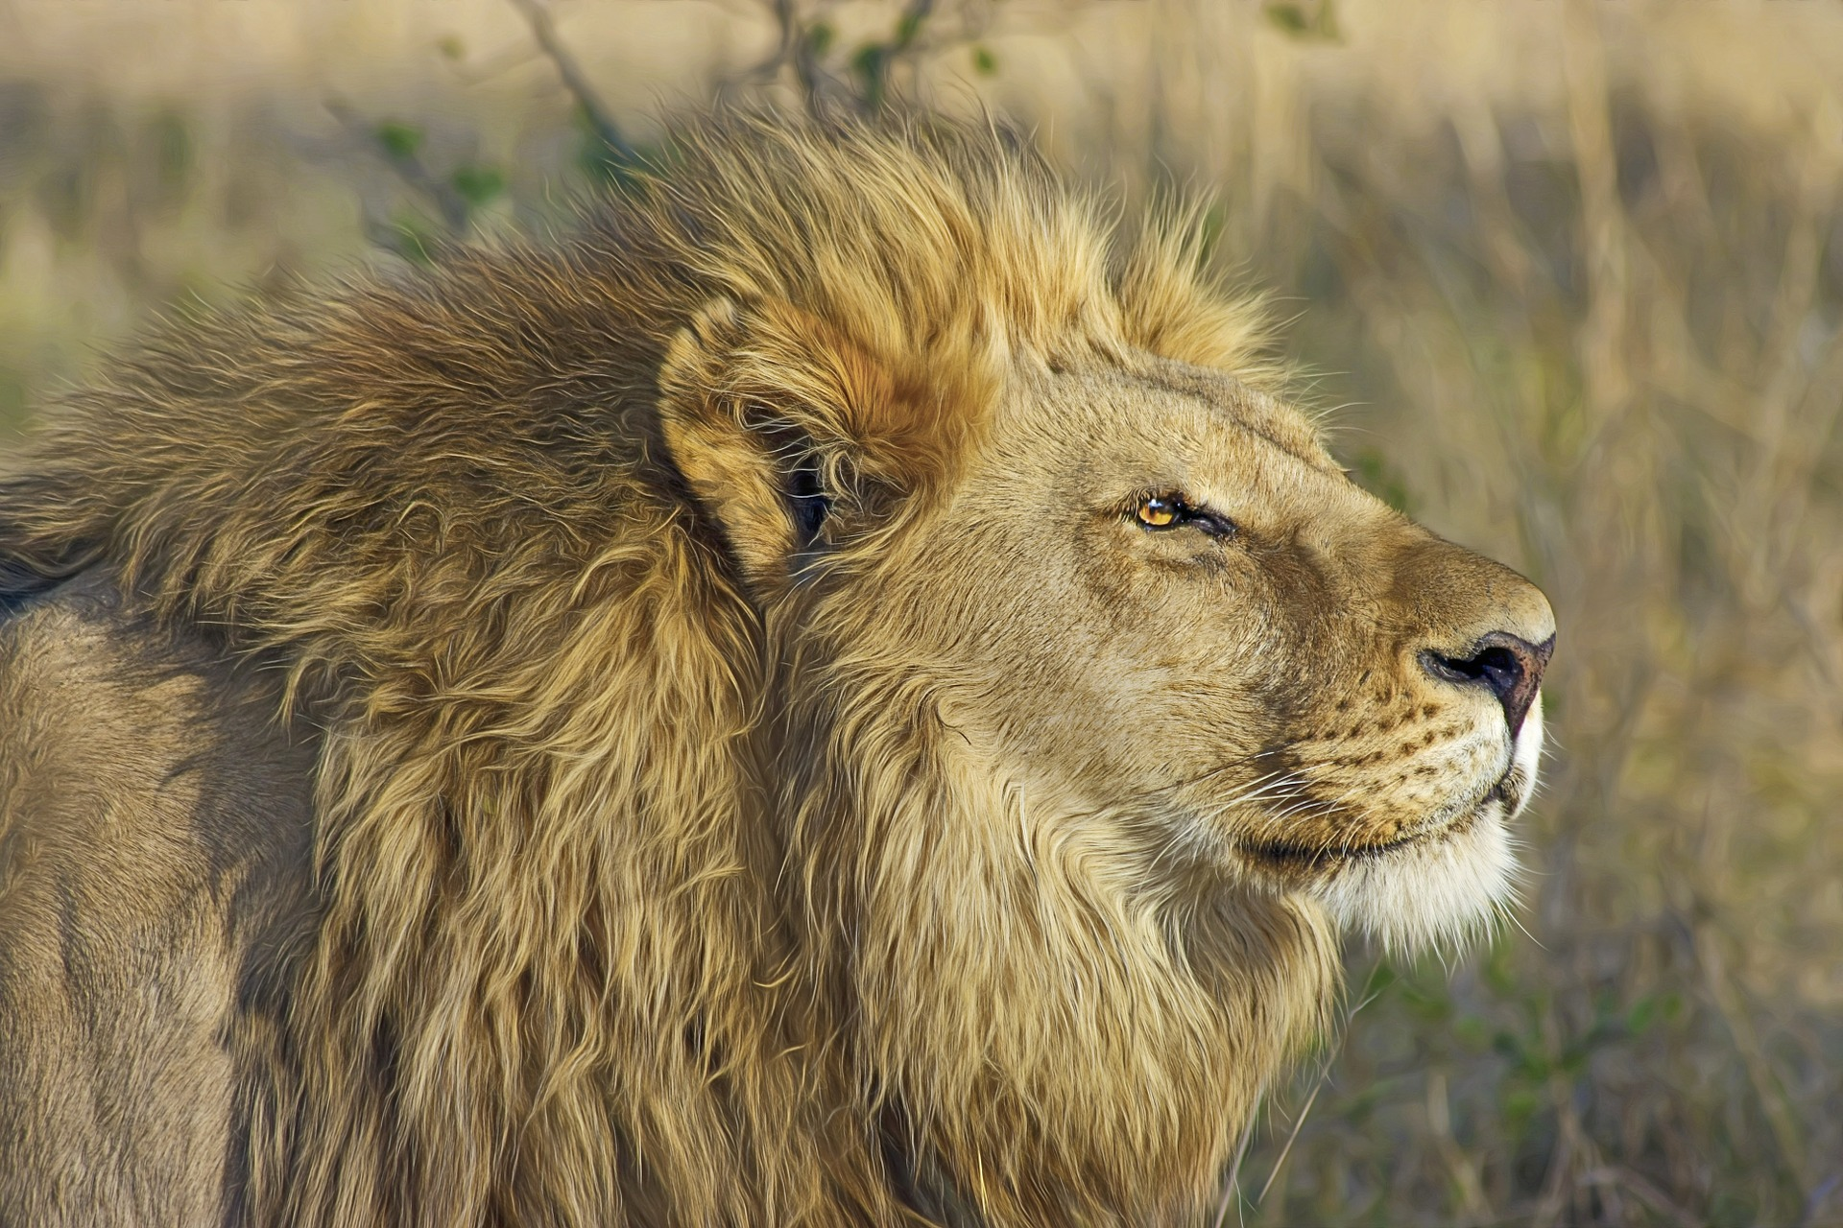
What Can Machine Learning Do?
Classify
LION
WILDLIFE
MAMMAL
Notes:
What can Machine Learning Do? - Classify
Say to the students, "Machine Learning is a system that trains on data to recognize patterns, and then uses those patterns to make predictions on new data. One common Machine Learning task is classifying objects through media such as images or audio. In this example, an image of a lion was uploaded to an classifier via the Google Cloud Vision API where it applied the labels, 'Lion', 'Wildlife', and 'Mammal'." This is similar to the previous example where Google Image Search found results for pizza.
Ask the students, "What other things could you possibly train a machine learning classifier to recognize?"
Some examples could include
speech for transcription or recognizing the language
music for determining the artist or genre
Say to the students, "A challenge with these types of problems can be if the system does not have enough information, it could misclassify an object or fail to know that this lion is also a type of cat"
Lion image

Slide 13
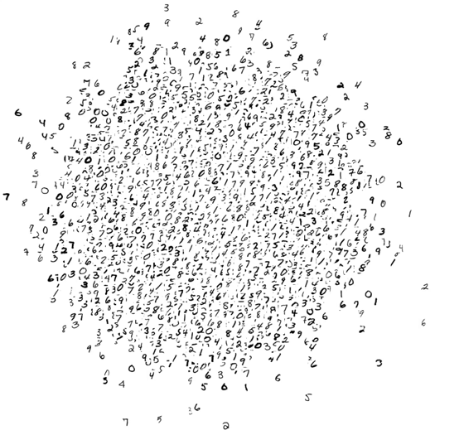






What Can Machine Learning Do?
Classify
LION
WILDLIFE
MAMMAL
Cluster
Notes:
What can Machine Learning Do? - Cluster
Say to the students, "Another example of the type of problem Machine Learning can be applied to is clustering similar objects. In this animation you are seeing a Machine Learning algorithm try to organize a set of data comprised of handwritten numbers 0-9.
The goal is for each number to be in a cluster with others like it (e.g. the 5s are with the other 5s) and the handwritten numbers that are similar to each other to be closer to each other within that cluster (e.g. 2s that have a bit more of a curve would be clustered together). These types of problems can be challenging because it can be hard to know what the threshold should be for example so the number 7 is recognized as a 7 and not considered the number 2"
Lion image

Slide 14
What Can Machine Learning Do?
Classify
LION
WILDLIFE
MAMMAL
Cluster
Recommend
Would you like to meet at 3pm?
Sounds good
I'll see you at 3
Sorry, I can't
Notes:
What can Machine Learning Do? - Recommend
Say to the students, "While there are other types of Machine Learning problems, another common one is prediction or recommendation. In this example, a text message was sent to another person asking if they want to meet at 3pm and the system is recommending responses based on how the person might respond." This is similar to the previous example where Google's Quickdraw application was able to predict what object you were drawing from a few lines.
Ask the students, "What are some other examples of predictions and recommendations you've seen?"
Some examples could include
Recommendations for next video to watch on YouTube or restaurants to try
Suggestions for typing corrections from your keyboard
Lion image

Slide 15


Example: YouTube
1
2
3
Notes:
Example - Video Recommendations
Say to the students, "YouTube is an example you may be familiar with. Whenever you watch a video, there are recommendations for the videos you might want to watch next."
Ask the students, "What type of information would you need in order to recommend a video to one of your friends?"
Some examples:
What types of videos they enjoy (comedy, music, educational)?
What videos have they watched before that they liked?
How much time they have to watch a video

Slide 16
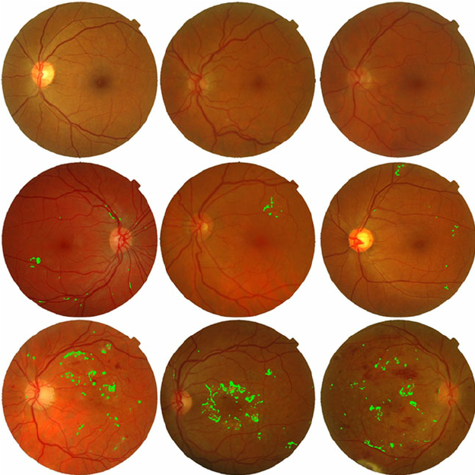
Example: Vision Loss from Retina Images
Notes:
Example - Predicting Vision Loss from Retina Images
Say to the students, "Machine Learning is not just for fun, it could be used to save lives. It turns out that given enough examples, machine learning systems are able to detect issues that previously could only be found by a trained expert. Here you’re seeing photographs of people's retinas (in the eye).
Normally only trained experts can look at these photos and detect problems with people's eyes, but now a machine is able to look at them and find the problems faster. Systems are also being trained to detect heart rhythm abnormalities in an EKG and more.
These examples were once science fiction but are quickly becoming a reality with potential to give everyone access to life-saving medical diagnoses."
Ask the students, "Would this be considered a classification, clustering, or recommendation type of Machine Learning problem?"
This is a classification machine learning problem because the system has been trained to classify whether or not a retina has vision loss based on training from other examples.
Retina Photographs From Automated Detection and Grading of Diabetic Maculopathy in Digital Retinal Images

Slide 17
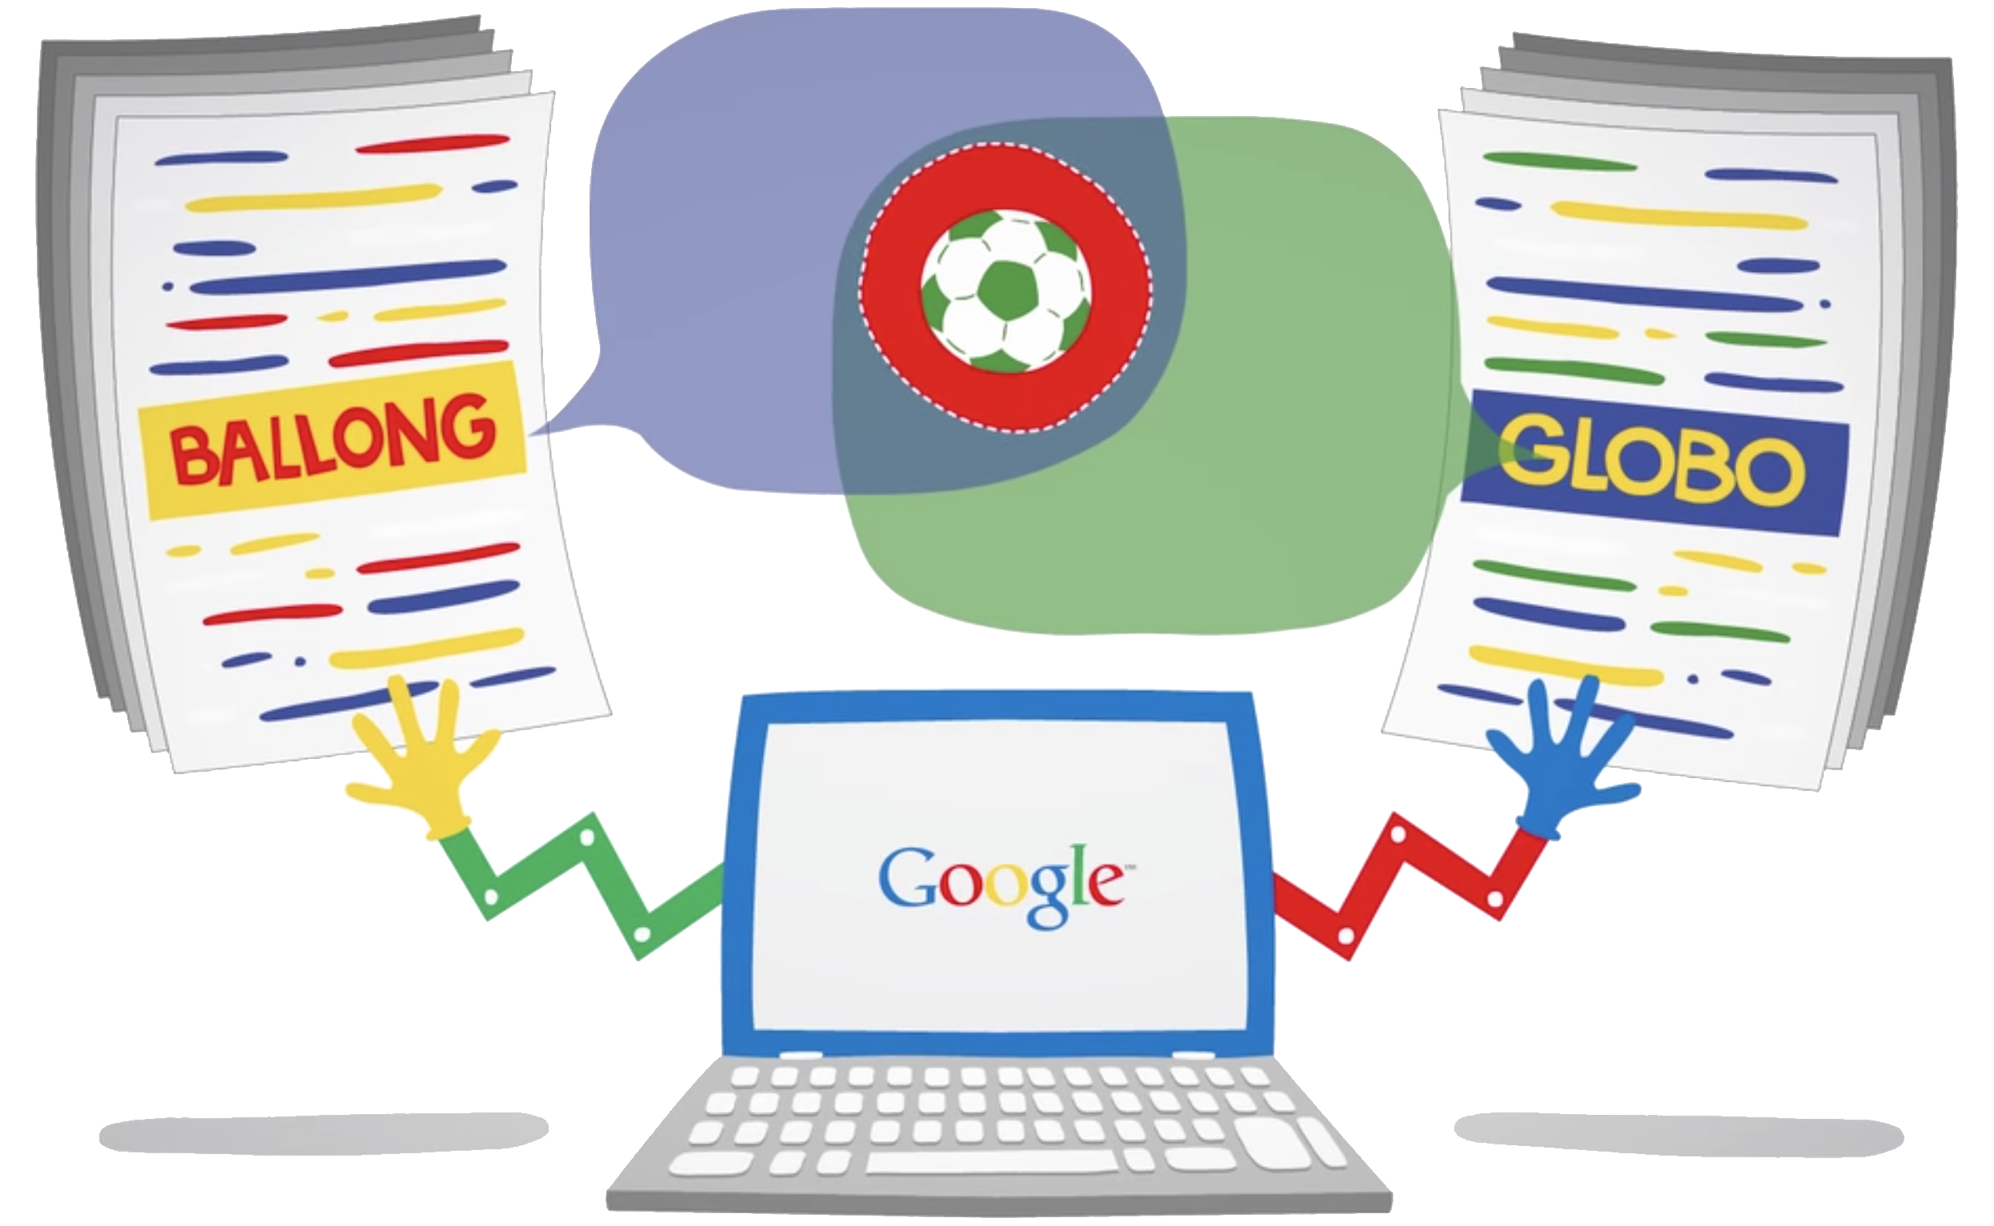
Example: Google Translate (previous version)
Notes:
Example - Google Translate (previous versions)
Say to the students, "Human experts have been key to high quality translation from one language to another. But what do you do with two people groups that have never interacted with each other and no one is available who knows both languages? This was the case for Egyptian Hieroglyphics until the Rosetta Stone was discovered.
For years, the method Google translate used was analyzing documents produced in multiple languages such as those from the United Nations and calculating word frequency and proximity to make a translation.
While this method performed and scaled better than explicitly programming each rules for each language, it still did not perform as well as a human translator."
From Inside Google Translate video

Slide 18
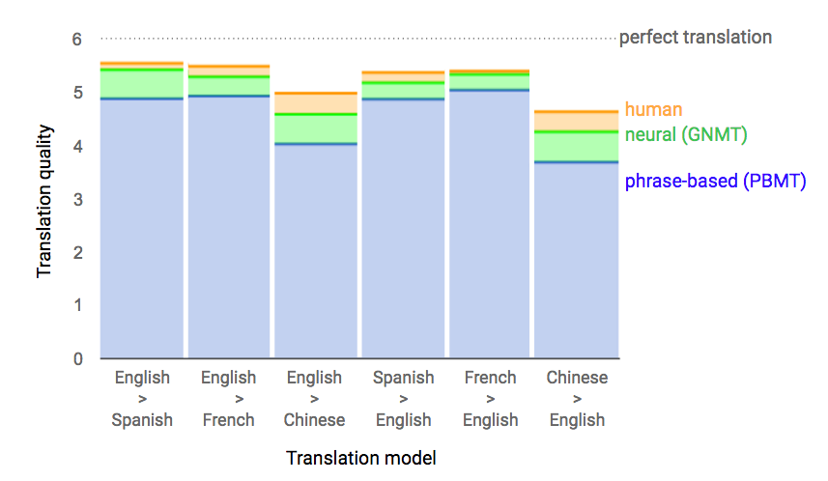
Example: Google Translate (deep neural network)
Notes:
Example - Google Translate (deep neural network)
Say to the students, "A deep neural network mimics how scientists believe the brain works and it is able to learn complicated patterns and relationships in data"
"In 2016 a machine learning system called a Deep Neural Network was implemented for Google Translate which was able to translate entire sentences rather than word-by-word (shown in green on the slide). This produced higher quality translations because they were based on the entire context of a sentence rather than a single word."
From A Neural Network for Machine Translation, at Production Scale

Slide 19
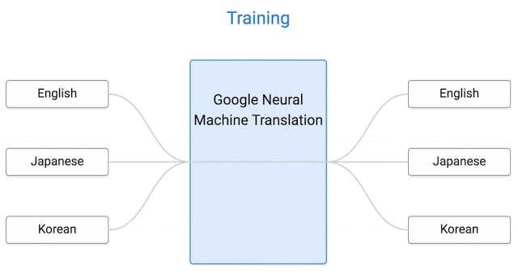
Example: Google Translate (zero-shot translation)
Notes:
Example - Google Translate (zero-shot translation)
Say to the students, "The performance of this system is still lower than that of human expert translators, but the benefit is the ability to translate between any two languages without first translating to a reference language like English and losing some of the nuance in translation. This is an example where a Machine Learning approach where a system learns from large amounts of data, surpassed what other methods were able to accomplish."
From Zero-Shot Translation with Google’s Multilingual Neural Machine Translation System

Slide 20
When to use ML?
Alphabetizing a list of song titles
Not ML
Ranking web search results
Both
Predicting housing prices from location data
ML
Processing online payments
Not ML
Recognizing an object in an image
ML
Creating a computer player for an Xs Os game.
Not ML
Creating a computer player for a chess game.
Both
Notes:
When to Use ML?
Ask the students which method would be ideal for applying machine learning or traditional programming.
Click to reveal each answer then click again to reveal the next line.
Explanation for each row:
Alphabetizing a list of song titles
not ML
It is a straightforward task that can be accomplished with traditional sorting algorithms.
Ranking web search results
Can be accomplished with both methods
It is both because one could use an algorithm like PageRank to rank results as Google did for many years but Machine Learning could be used to rank and recommend results to a user.
Recognizing an object in an image
ML
The number of possible objects is too large to efficiently use traditional programming. Machine Learning can make this process more efficient by learning patterns such as the wheel on a car rather than needing to scan every pixel.
Creating a computer player for an Xs Os game (aka Tic-Tac-Toe)
Not ML
The space of potential moves and rules of the game are small enough to be captured in a succinct algorithm.
Creating a computer player for a chess game.
Both
There are many traditionally programmed chess algorithms that are able to compete at an expert level. A sufficiently well trained machine learning system could have enough learned intelligence to compete in situations it has not seen before (see AlphaGo).

Slide 21
Brainstorm
How could machine learning be applied to the ways you use a computer* each day?
* Laptop, phone, tablet, etc.
Notes:
Say to the students:
At the beginning of this session you shared ways you use a computer each day
Remind the students of a few of these either on the whiteboard or from the list you kept
Ask the students, "How could machine learning be applied to the ways you use a computer each day?"
After this brainstorming is complete, have students raise their hands to share the list of tasks they created.

Slide 22
Each has its benefits
Traditional Programming
Machine Learning
System learns patterns from data Improvements may also come from additional data
Explicit instructions from programmer Improvements come from better algorithms
Notes:
Recap
Say to the students, "This discussion was a quick overview of what Machine Learning is and where it can be useful. You may have already programmed an application like the ones you run on your phone. These apply programming and computer science where the system runs based on what it has been explicitly instructed to do. Machine Learning can be implemented in those programs to enable new functionality like the ability to recognize, recommend, and predict. In the next section you will implement Machine Learning into an application to get a sense what is possible and how you might apply this in your own software."

Slide 24
Getting Started with Machine Learning
Session 2: Using Machine Learning
Notes:
Facilitator doc

Slide 25
Learning Objectives
By the end of this session, you will be able to:
1
2
Explain how Google’s CloudML platform can be used to create different ML applications.
Design and implement a simple app that uses Google’s Cloud APIs.

Slide 26
Introduction to Machine Learning APIs

Slide 27
Review: What can Machine Learning be used for?
Review: What can ML be used for?
In the last session, we classified Machine Learning applications into 3 different categories.
Can you remember what these categories were?
Classification
Clustering
Recommendation
Notes:
Ask the question “What can Machine Learning be used for?”
Explain to students that they will be brainstorming as many potential applications as possible.
To prompt thinking, encourage them to consider the three categories of Machine Learning examples
Ask students to volunteer what they are before revealing answers - classification, clustering, recommendation.
Light Bulb is open source

Slide 28
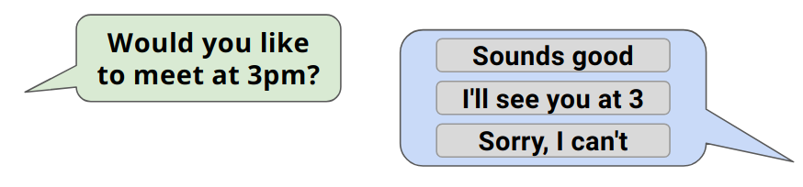
Review: What can ML be used for?
Types of
Machine Learning
Classification
Clustering
LION
WILDLIFE
Recommendation
MAMMAL
How many examples of Machine Learning can you brainstorm?
Notes:
Once the categories have been revealed, give students 3 minutes to create a brainstorm of types of Machine Learning.
This should be completed on large pieces of paper with board pens, but could be completed electronically if resources aren’t available.
The task can be completed as an independent or collaborative task, depending on the preference of the facilitator.

Slide 29
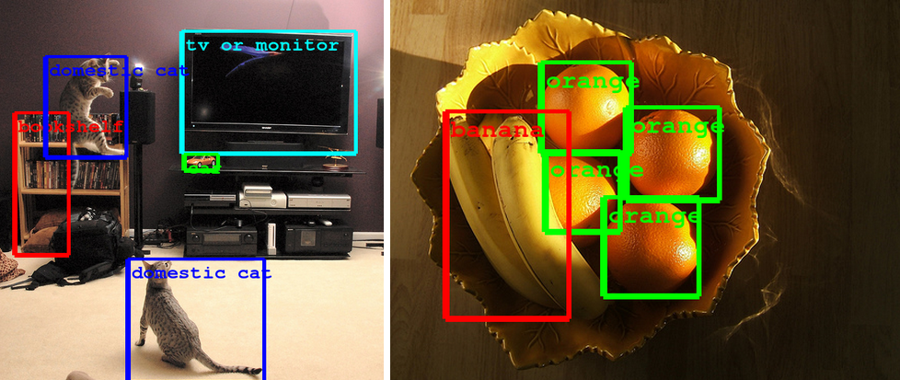
Image Recognition
Used to detect individual features / components of an image.
Notes:
Facilitator to describe the technology seen in the picture. Can students think of any other instances where this technology would be useful?
Try to link to autonomous cars, robotics etc.
Image

Slide 30
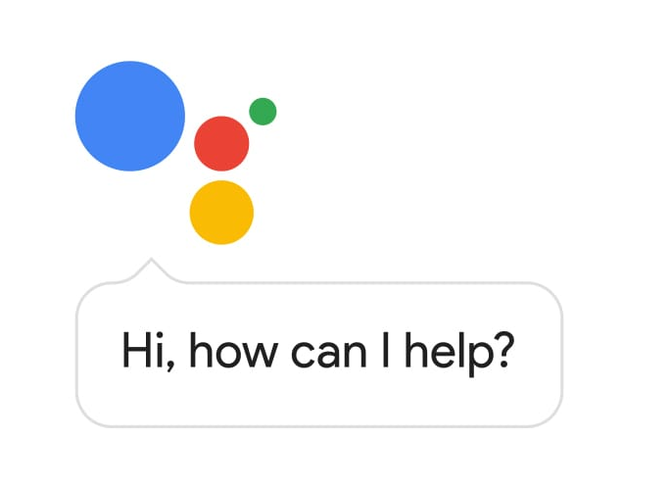
Space Recognition
Translating spoken word to text (Transcribing)
Language detection
Notes:
Facilitator to describe speech recognition. Can students identify why this is useful? Where have they seen / used this already?
Link to voice assistants
Image (left)

Slide 31
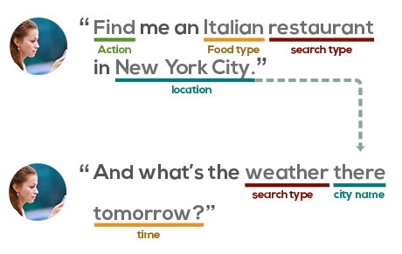
Natural Language Understanding (NLU)
Being able to understand and respond to language.
Notes:
Facilitator to describe Natural Language Understanding ML - where have students seen examples of this technology. Facilitator should give students the opportunity to explain their understanding of NLU
Image

Slide 32
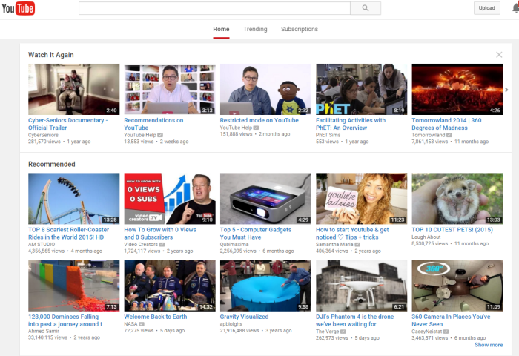
Personalized Recommendations
YouTube recommendations.
Learning and predicting what a user might like.
Notes:
Facilitator to describe Personalised Recommendation ML. Can students describe any similar examples?
Discuss how the process of manually selecting recommendations would be a large task to do for lots of people. Emphasise efficiency of using Machine Learning.
Image

Slide 33
What is a function, in programming terms?
Notes:
Ask the students if they can recall what is meant by a function, in terms of programming.
You may want to give them a short amount of time to think or discuss answers in pairs before taking answers.

Slide 34
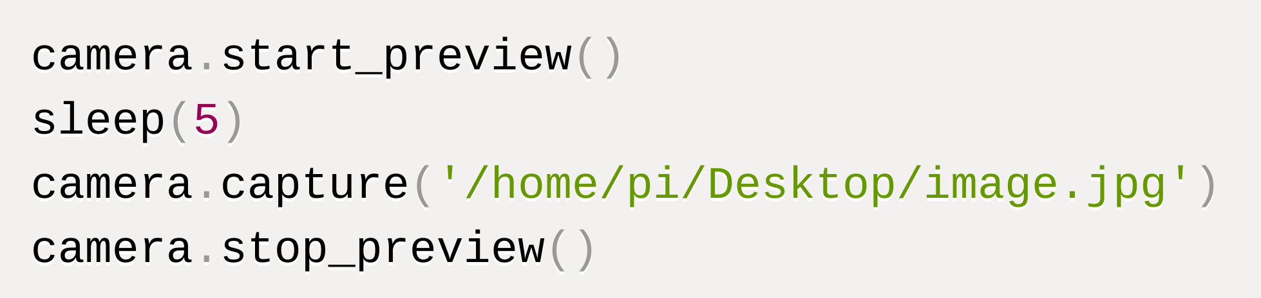
Functions in Programming
A function is a block of code which you can use just by knowing its name.
You don’t need to know how it works!
Function examples:
How many other functions can you think of?
You can use the round function in JavaScript without understanding the code that runs to actually do the rounding.
You can use Python functions to control a camera without understanding the code that is being run to do this.
Math.round(3.18)
Notes:
Explain what a function is used for, and explain the two examples.
Emphasise that a function allows code written by someone else to be run to achieve a task, without understanding how this code works.
Ask students to give further examples of functions that they may be familiar with.
Examples could include:
Inputting or outputting data
Converting between data types
Performing mathematical calculations
Drawing to the screen
Manipulating data structures such as lists

Slide 35
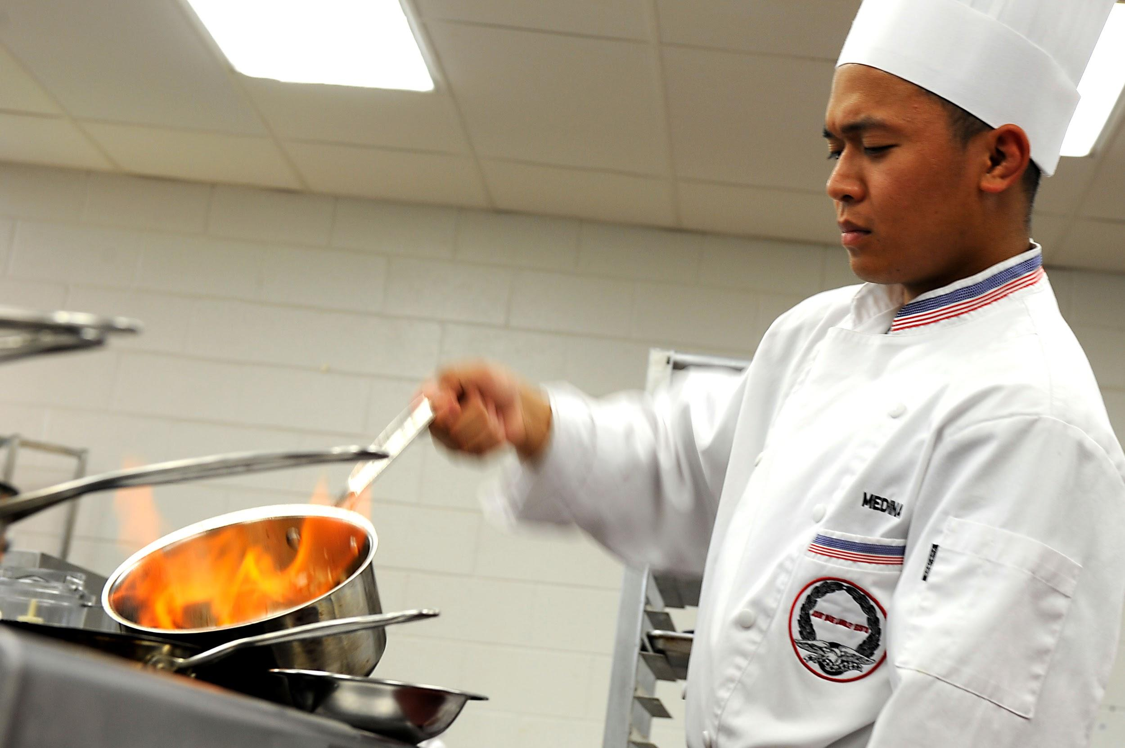
Functions in Programming
A function is a block of code which you can use just by knowing its name.
You don’t need to know how it works!
How is ordering a meal like using a function?
Notes:
Ask students how ordering a meal is like using a function.
You may want to give 30 seconds thinking or discussion time before taking answers.
Chef image is open source

Slide 36


Functions in Programming
A function is a block of code which you can use just by knowing its name.
I’ll have the “tomato and coconut cassoulet,” please
Coming up!
You can get the result you want just by knowing the right name - you don’t have to understand how it is created!
Notes:
Play the very short animation on the slide and explain that ordering a meal is like using a function because:
In each case, you just need to know the name of what you want to happen
In each case, someone else is responsible for doing the work
In each case, you get the result back without understanding how it was created
Face is open source
Chef image is open source

Slide 37

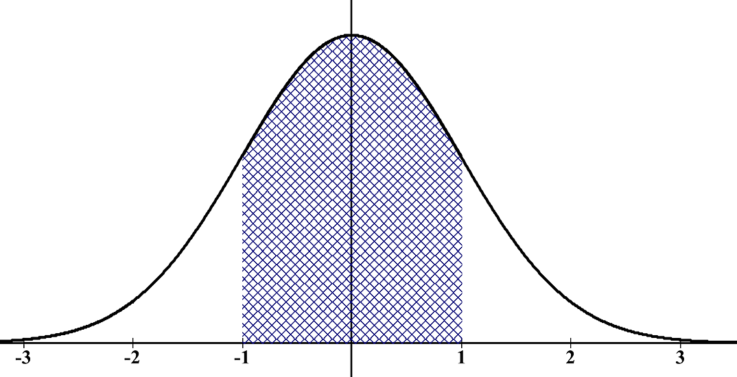
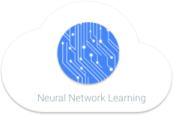

Application Programming Interfaces
An Application Programming Interface, or API, is a collection of functions which are used to access features written by someone else.
An API with functions for encrypting and decrypting data | An API for doing statistical calculations
An API for easily reading and writing files | An API for Machine Learning
Notes:
Explain that an API is a collection of functions which are used to access a set of related features. Talk through the examples.
Continue to emphasise that each function in the collection can be used without understanding how it works.
An API for encryption and decryption would allow you to encrypt (scramble so only certain people can unscramble) and decrypt (unscramble) data without understanding how this works
An API for statistical calculations could allow you to find averages, ranges, probabilities, statistical distributions, confidence intervals, and other things, without having to code these yourself
An API for reading and writing file allows you to easily work with files, without having to understand the computer’s operating system or writing code that works with it
An API for machine learning could allow you to use powerful machine learning techniques without having to fully understand how to program them
To check students’ understanding, you could ask them for examples of functions that could be included in one of the example APIs, or you could ask students to suggest another example of an API.
Encryption image is open source
Stats image is open source
File image is open source

Slide 38
Application Programming Interfaces
An Application Programming Interface, or API, is a collection of functions which are used to access features written by someone else.
A restaurant menu is like an API because it provides you with a selection of dishes.
Each dish is like a function because you can get the result by just knowing its name.
How is a restaurant menu like an API?
Notes:
Ask students how ordering from a menu is like using an API.
You may want to give 30 seconds thinking or discussion time before taking answers.
Click to show the correct answer:
A restaurant menu is like an API because it provides you with a selection of dishes to choose from.
Each dish is like a function because you can get the result by just knowing its name and asking for it.

Slide 39


What is Web API?
Client
(Your Computer)
The Web
(Connects Client & Server)
Server
(Website Computer)
Notes:
If you are not sure that students are confident with the terms, you may need to explain that a client is a computer that accesses a service and a server is a computer that provides a service. Advance the slide.
Laptop is open source
Server is open source

Slide 40
What is a Web API?
What is Web API?
Request
Request
Computing
Response
Response
Client
(Your Computer)
The Web
(Connects Client & Server)
Server
(Website Computer)
Notes:
Explain how a Web API works. Say that:
Some APIs work by using the World Wide Web.
You call a function by sending a message containing your request to a web address.
The server does the working out, then sends you back a response.
This allows you to access services provided by others on the Internet. Like other APIs, the great thing is that you don’t have to understand exactly how they work.

Slide 41
What is Web API?
Request
Response
Client
(Your Computer)
The Web
(Connects Client & Server)
Server
(Website Computer)
Notes:
This slide is a still image representing the process, which you might want to use in your explanation.

Slide 42
Flight Booking API
get_flights(start_city, end_city, date)
book_ticket(flight_number, payment_details)
Client
(Your Computer)
The Web
(Connects Client & Server)
Server
(Website Computer)
Notes:
State that an example of booking flights will be used to show how Web APIs work.
Explain that get_flights is a function used to fetch information about different flights; if you give a start city, end city and particular date, the server will tell you what times the relevant flights leave.
Explain that book_ticket is a function used to request a flight booking; if you specify a particular flight and give valid payment details, the server makes a reservation for you.
Now might be a good time to mention that normally, an API has documentation very clearly explaining exactly how each function works.
You could ask who might own the client (someone wanting to buy a flight ticket) and who might own the server (an airline).

Slide 43
Flight Booking API
get_flights(start_city, end_city, date)
book_ticket(flight_number, payment_details)
get_flights(Abu Dhabi, London, 13/07/2020)
get_flights(Abu Dhabi, London, 13/07/2020)
Getting flights...
[7:50, 13:00, 18:30]
[7:50, 13:00, 18:30]
Client
(Your Computer)
The Web
(Connects Client & Server)
Server
(Website Computer)
Notes:
Click through the animation showing a request being made, result being computed, and response being returned.
It could be useful to ask students questions such as “What do you think the next step will be?” to get them to think.

Slide 44

Flight Booking API
get_flights(start_city, end_city, date)
book_ticket(flight_number, payment_details)
Jump to Quiz
Request
Response
Client
(Your Computer)
The Web
(Connects Client & Server)
Server
(Website Computer)
Notes:
This slide again shows a still summary of the whole process.
It may be worth pointing out that in this context, there is no difference between a laptop and a smartphone; they are both client computers.
The button at the top of the slide can skip ahead if students are clearly confident.
Mobile phone is open source

Slide 45
Flight Booking API
get_flights(start_city, end_city, date)
book_ticket(flight_number, payment_details)
book_ticket("GF547", 7391033867273220)
book_ticket("GF547", 7391033867273220)
Booking flight...
Booking confirmation
Booking confirmation
Client
(Your Computer)
The Web
(Connects Client & Server)
Server
(Website Computer)
Notes:
Click through the animation showing a request being made, result being computed, and response being returned.
It could be useful to ask students questions such as “What do you think the next step will be?” to get them to think.

Slide 46
Flight Booking API
get_flights(start_city, end_city, date)
book_ticket(flight_number, payment_details)
book_ticket("GF547", 0123456789)
book_ticket("GF547", 0123456789)
Booking flight...
Error: invalid payment details
Error: invalid payment details
Client
(Your Computer)
The Web
(Connects Client & Server)
Server
(Website Computer)
Notes:
This example shows that an API might not always give a successful result; here, invalid payment details are given, so the ticket is not booked.

Slide 47
Jump to Quiz
New Flight Booking API
get_flights(start_city, end_city, date)
book_ticket(flight_number, num_tickets, payment_details)
Client
(Your Computer)
The Web
(Connects Client & Server)
Server
(Website Computer)
Notes:
This slide and the next show what can happen if an API is changed.
Point out that the second function in the API has changed; it now allows you to book multiple tickets by specifying a number of tickets to reserve.

Slide 48
New Flight Booking API
get_flights(start_city, end_city, date)
book_ticket(flight_number, num_tickets, payment_details)
book_ticket("GF547", 7391033867273220)
book_ticket("GF547", 7391033867273220)
Booking flight...
Error: request missing num_tickets
Error: request missing num_tickets
Client
(Your Computer)
The Web
(Connects Client & Server)
Server
(Website Computer)
Notes:
Point out that the client is still trying to use the old version of the API - it has failed to include the number of tickets.
As a result, the server has not processed the request and returned an error message.
To deepen understanding, you could ask students why it is important to communicate well if you are changing an API. The answer is that if the change is not well-communicated, programmers who have used your API might not update their code, so their applications stop working when the API change is made.

Slide 49
Hinge-Point Quiz
What does API stand for?
Autonomous Programmed Input
Amazing Pink Iguana
Application Programming Interface
Automatic Process Initiation
What does API stand for?
Autonomous Programmed Input
Amazing Pink Iguana
Application Programming Interface
Automatic Process Initiation
Click here to skip quiz
Notes:
This short quiz is to check whether the students have learnt what has been taught - if they get the questions wrong, the content needs to be revisited.
Pose each question, then gather student responses, then reveal and explain (or get a student to explain) the correct answer.
To gather student answers, you could simply ask them, or use mini-whiteboards, or gather student responses digitally.
Iguana image

Slide 50
Hinge-Point Quiz
When might you use an API when writing a program?
To use features that have been coded by other people
To automatically complete lines of code
To communicate using the Internet
To check code for bugs
When might you use an API when writing a program?
To use features that have been coded by other people
To automatically complete lines of code
To communicate using the Internet
To check code for bugs

Slide 51
Hinge-Point Quiz
If you are a programmer, why might you implement an API?
To allow your programs to be executed in parallel
To make sure that no one else can benefit from your work
To allow other programmers to use your work without necessarily understanding how it works
To ensure that your code has no bugs
If you are a programmer, why might you implement an API?
To allow your programs to be executed in parallel
To make sure that no one else can benefit from your work
To allow other programmers to use your work without necessarily understanding how it works
To ensure that your code has no bugs

Slide 52
Hinge-Point Quiz
Which statement is false, and why?
To use a Web API, the client sends a request to the server using the Web.
When it receives a request, the server does any required processing.
When it has worked out the result, the server creates a new web page displaying the result.
Client
(Your Computer)
The Web
(Connects Client & Server)
Server
(Website Computer)
Notes:
Advance the slide to reveal which statement is false.

Slide 53
Hinge-Point Quiz
Which statement is false, and why?
To use a Web API, the client sends a request to the server using the web.
When it receives a request, the server does any required processing.
When it has worked out the result, the server creates a new web page displaying the result.
Client
(Your Computer)
The Web
(Connects Client & Server)
Server
(Website Computer)
Notes:
Ask students to explain why the statement is false, and what the right statement would be.
Advance the slide to reveal what the correct statement would be.

Slide 54
Hinge-Point Quiz
Which statement is false, and why?
To use a Web API, the client sends a request to the server using the web.
When it receives a request, the server does any working out it needs to.
When it has worked out the result, the server creates a new web page displaying the result. sends the result back directly to the client.
Client
(Your Computer)
The Web
(Connects Client & Server)
Server
(Website Computer)

Slide 55
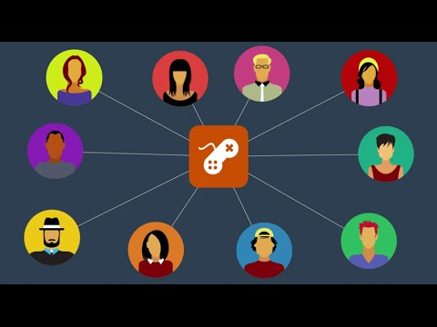
Creating APIs for Game Developers
Notes:
This video offers another explanation of APIs, using the context of leaderboards for game development. If the quiz showed that students understand what an API is, then it is probably best to skip this and move on.

Slide 56









Notes:
State that:
Google provides many Web APIs for lots of different things (illustrated on the slides)
Some of them can be used to do Machine Learning
Today, we will be learning how to use these APIs
Use the links to demonstrate each API in turn, giving students a chance to try them out if possible before moving to the next one. See the instructor guide for full details, but in short:
The Vision API lets you upload an image, which is analysed to find relevant labels, recognise landmarks and objects, detect faces and facial expressions, and read text
The Speech API analyses sound files to transcribe speech
The NL API

Slide 57
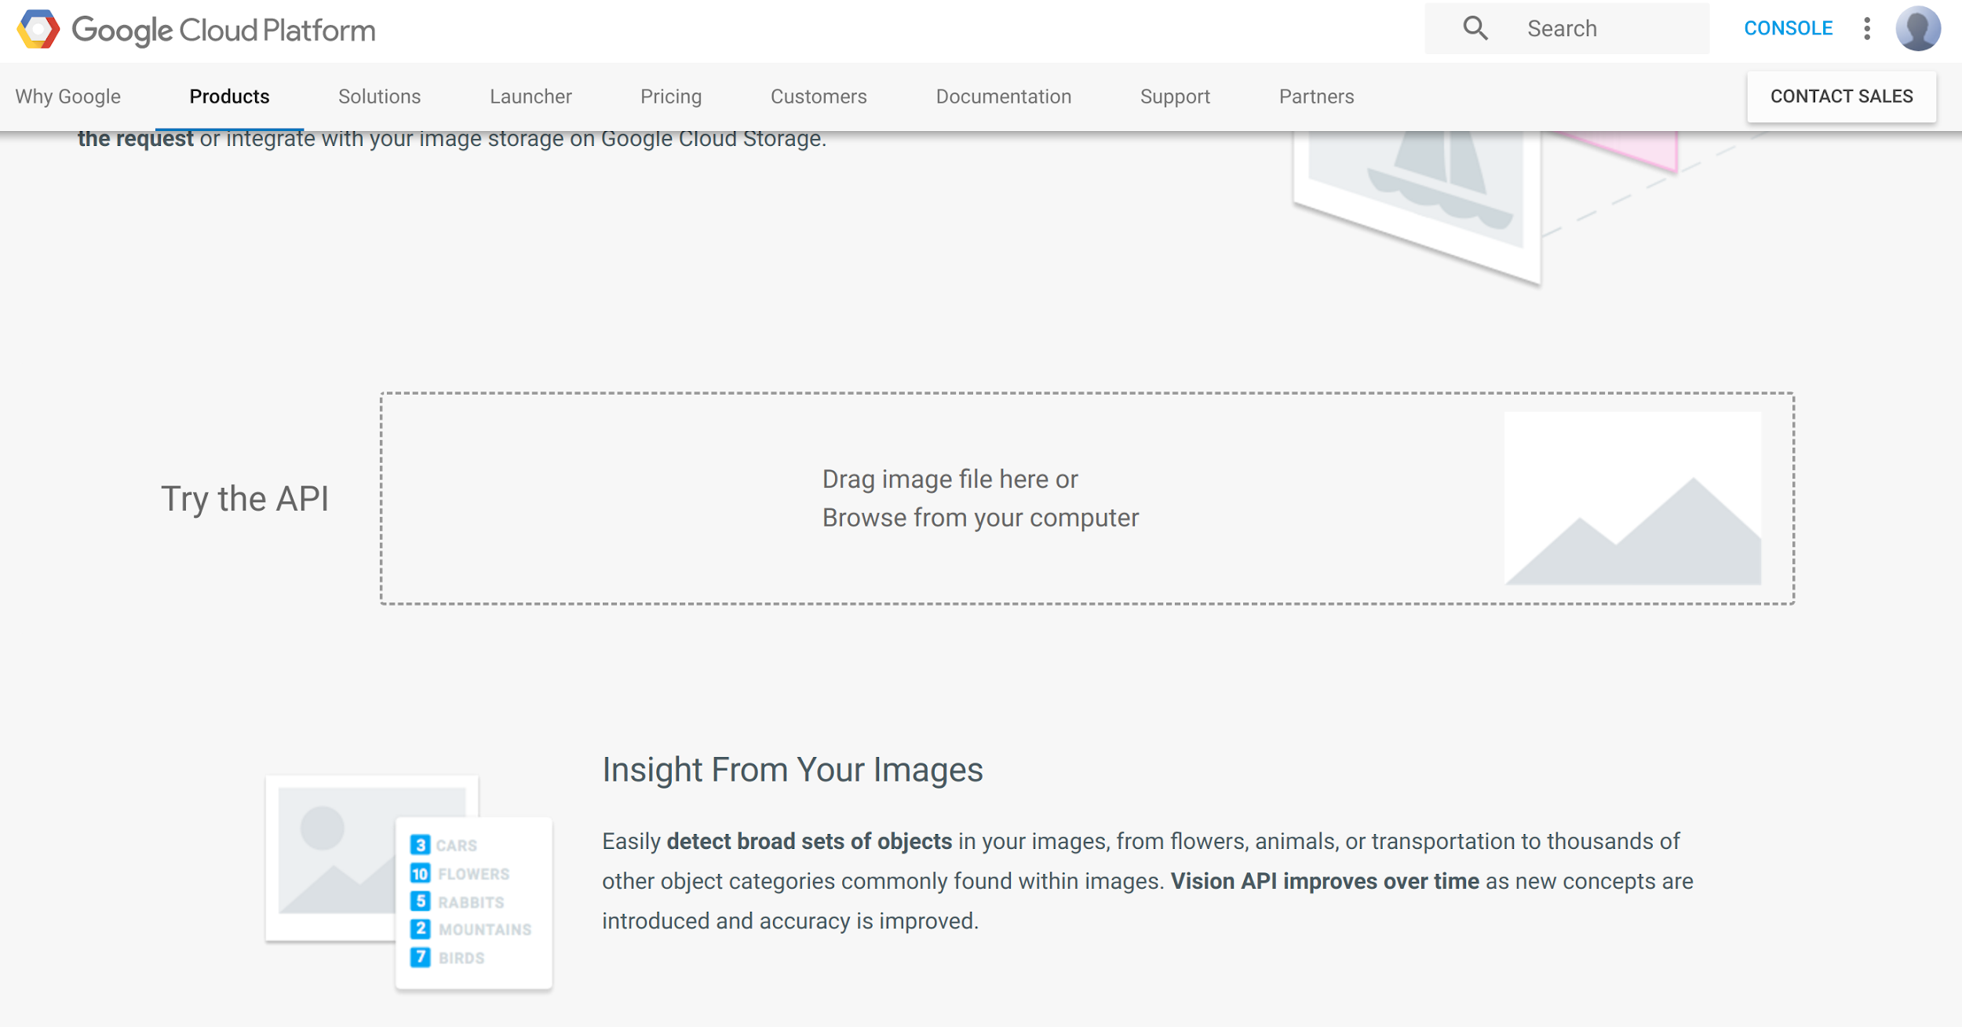
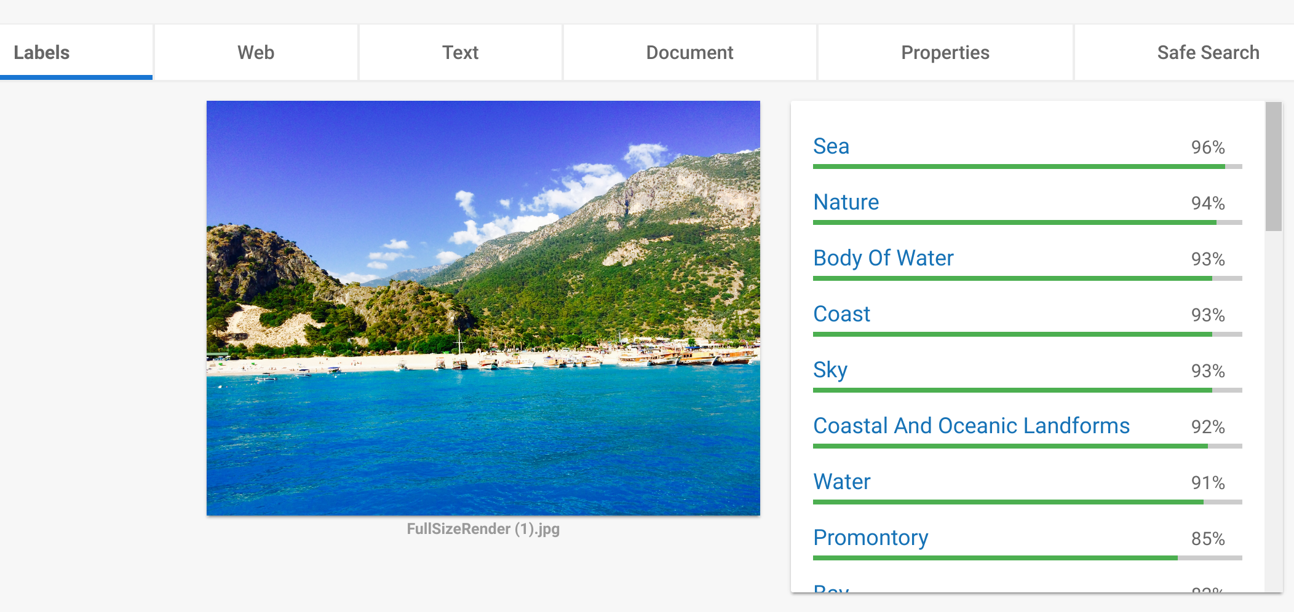
Demo: Vision API
cloud.google.com/vision/
Notes:
Screenshots taken from link above.
NOTE: Students will perform a similar image classification activity later (see Slide 72), so it’s probably a good idea to walk through this demo relatively quickly, as they’ll be doing a more in-depth exploration of image labeling in the Designing section.
The first API we will look at is the Vision API. It can be used to identify the things that might be in an image.
Demo loading up the web address. Show the class where the API test box can be found and upload a sample picture. Click through the tabs to show the class the different pieces of data returned by the API.
We can click through different pieces of data returned by the API. Notice that we are presented with a series of labels or descriptors. Each label is accompanied with a percentage of the likelihood that it is in the image. The API can never be 100 percent certain that something is in an image, but it can be highly certain.
Take some time now to try the API using the link on screen in your web browser.
Circulate the room, supporting students with using the API.

Slide 58
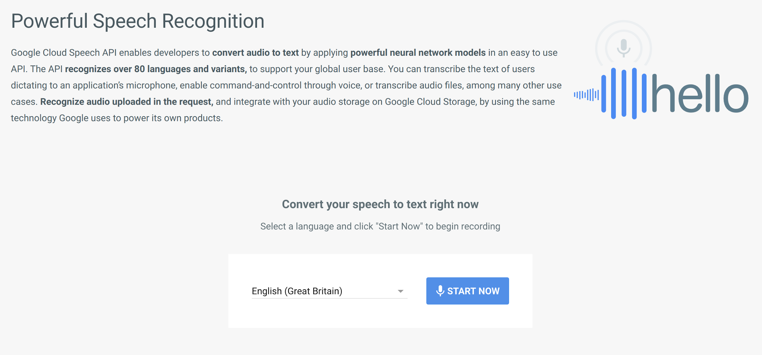
Demo: Speech API
cloud.google.com/speech/
Notes:
Screenshot taken from link above.
The next API performs a function that many of you will be familiar with. It takes an audio signal and turns it into text.
Point students to the web link. They shouldn’t need a demonstration as the UI is very self-explanatory. Allow for 2 minutes for students to experiment with the API. Encourage them to experiment with different languages / phrases / speeds of speech.

Slide 59
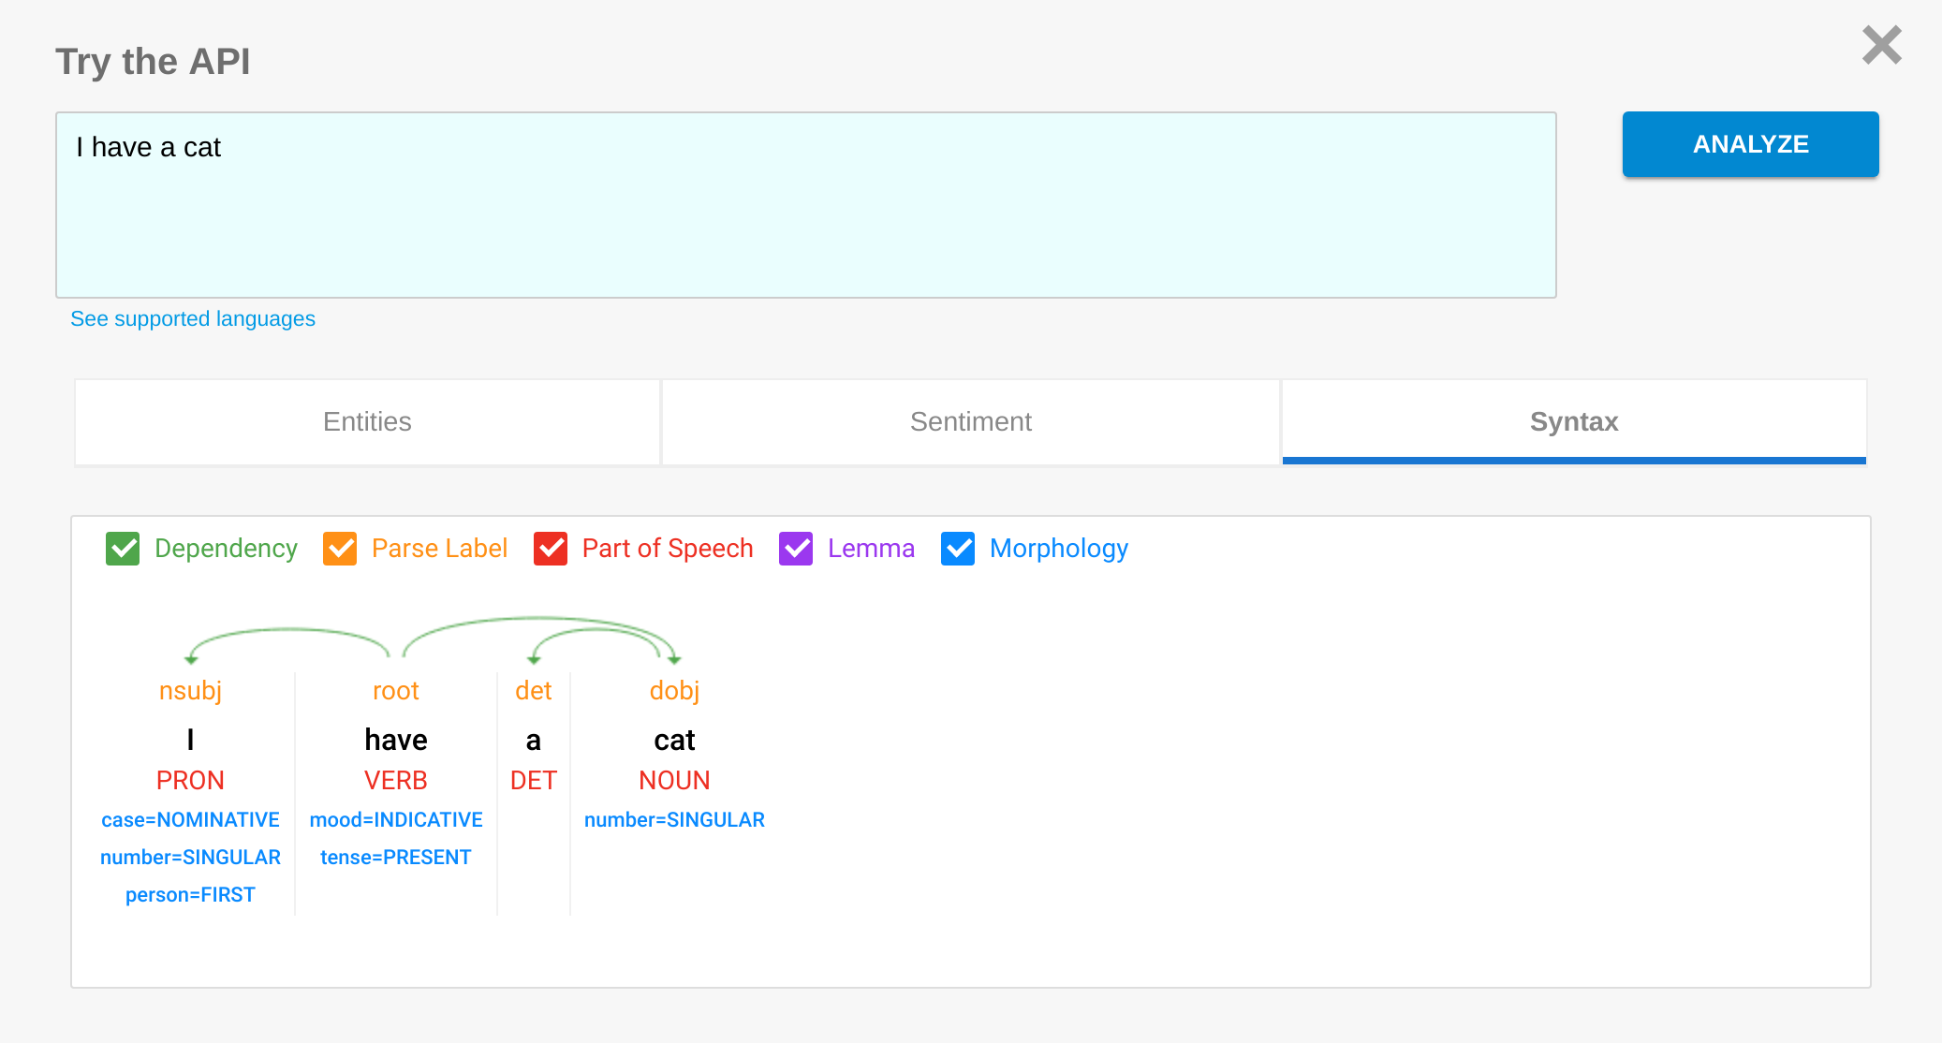
Demo: Natural Language Understanding API
cloud.google.com/natural-language/
Notes:
Screenshot taken from link above.
The final API we will look at is the Natural Language Understanding API. It is capable of breaking down a sentence and understanding the meaning behind text. This can be used in conjunction with other software to generate intelligent responses to text as seen in Google Allo.
Demo using the API to the class - it is unlikely that students will want to use this API in the practical section, however encourage them to try it out later in the class if they wish.

Slide 60

Which CloudML APIs could each application use?
Application | Vision | Speech | Natural Language
Identifying which images in an album of an event contain happy people, so these can be uploaded
Analysing tweets about a new product to get immediate data on what people think
Identifying in real time if a caller to a radio show has used inappropriate language
Searching through a library of scanned book images to find mentions of Machine Learning
Providing music recommendations based on the songs the user has been listening to recently
Using voice control to tell a phone to take a group photo, and retake if anyone has their eyes closed
Notes:
This quiz is to check students’ understanding of the APIs. Click to show the next question, then ask students which of the APIs each application could use, then click again to reveal the answer.
The second-last question is unlikely to use any of the APIs discussed; it is worth emphasising that not all machine learning applications simply use these APIs!
Tick image is open source

Slide 61
Designing a Machine Learning App

Slide 62
What can we make?
Notes:
Facilitator should link back to previous Machine Learning examples. Describe simple apps that might be useful to create. For example, an app that detects whether there is a dog in a picture or a listening app that listens out for a specific word or phrase.

Slide 63
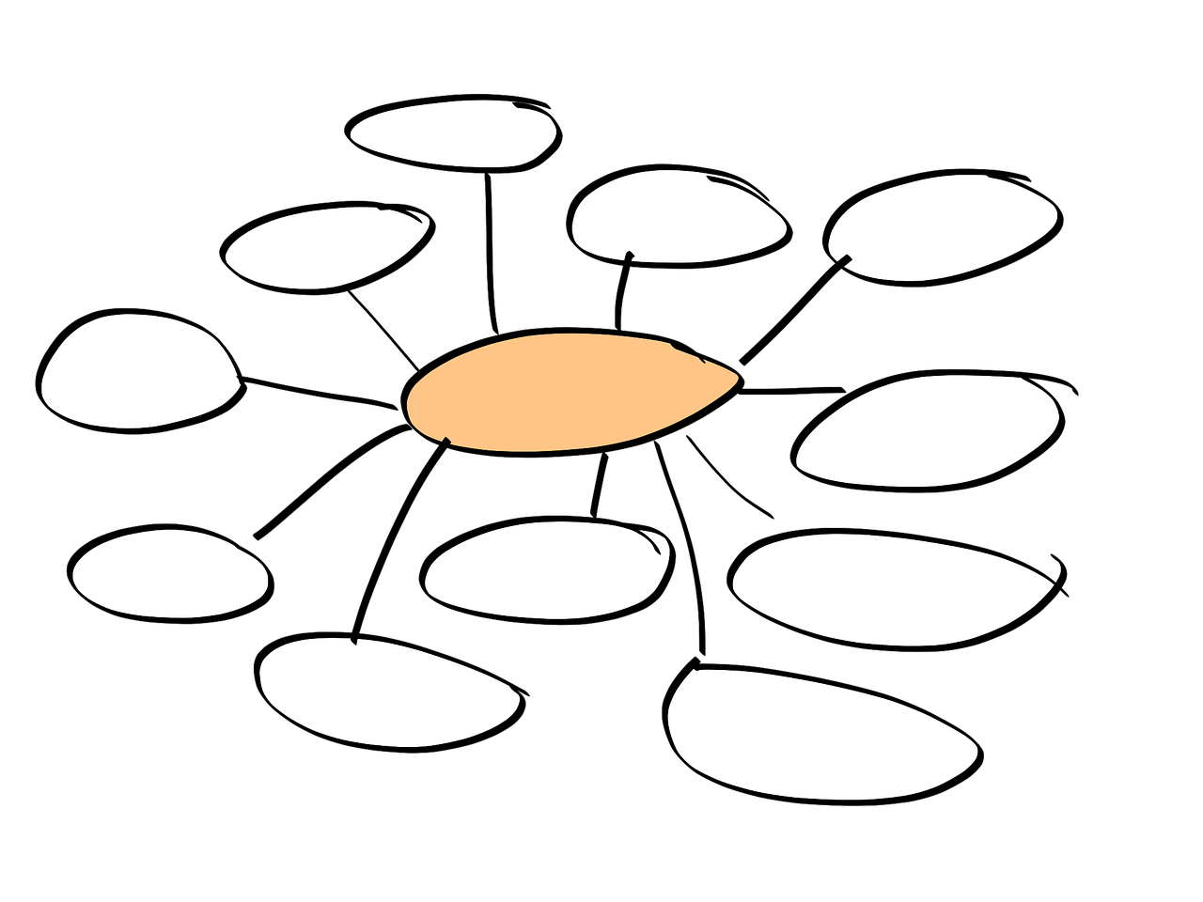
Brainstorming App Ideas
In small groups, brainstorm simple and achievable
app ideas that you can build in 60 minutes.
The app should:
Examples:
An app that detects whether a dog is in an image
An app that counts the number of people in an image
An app that detects whether a specific word is said in a sound recording
Get user input
Call an API
Process the response
Output the result
Notes:
Explain that students will need to break into small groups of 2, 3 or 4. Together, they must brainstorm simple app ideas for how they will use the APIs. WHilst they are brainstorming and developing their ideas; the instructor should circulate the room, ensuring that all ideas are feasible within the given time.
Image

Slide 64

Finalize Your App Idea
Spend 2 minutes agreeing as a group what your final idea will be.
Notes:
Say to the students, "With the person seated next to you, brainstorm a list of ways you use computers"
After this brainstorming is complete, have students raise their hands to share the list of tasks they created.
Write these as a list on the whiteboard or keep track of them somehow, as you will refer to them at the end of the session.

Slide 65

Sharing Your App Ideas
Each group takes about 30 seconds to share their app idea.
Notes:
Say to the students, "With the person seated next to you, brainstorm a list of ways you use computers"
After this brainstorming is complete, have students raise their hands to share the list of tasks they created.
Write these as a list on the whiteboard or keep track of them somehow, as you will refer to them at the end of the session.

Slide 66
Build Our Apps

Slide 67
Introduction to the Web App
Given an image passed as input, attempt to detect different types of features, such as:
Labels
Faces
Text
Logos
Landmarks
Web annotations
Properties (such as dominant color in the image)

Slide 68
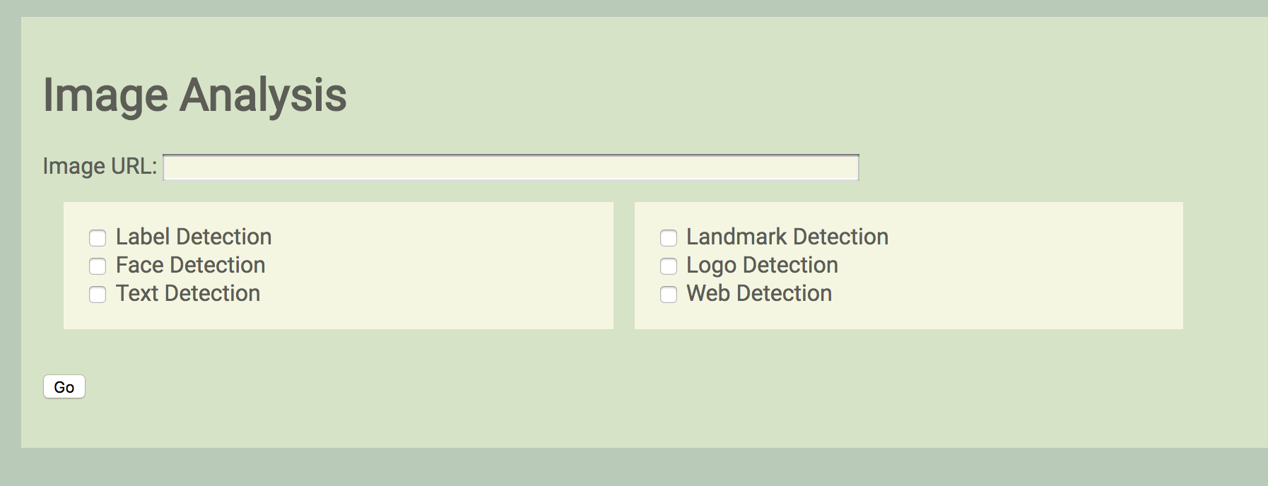
Getting Started with the App
Add a web link to an image
Select labels you’d like to search for
Click “Go!” to see what was detected

Slide 69

What labels would you give this image?

Slide 70
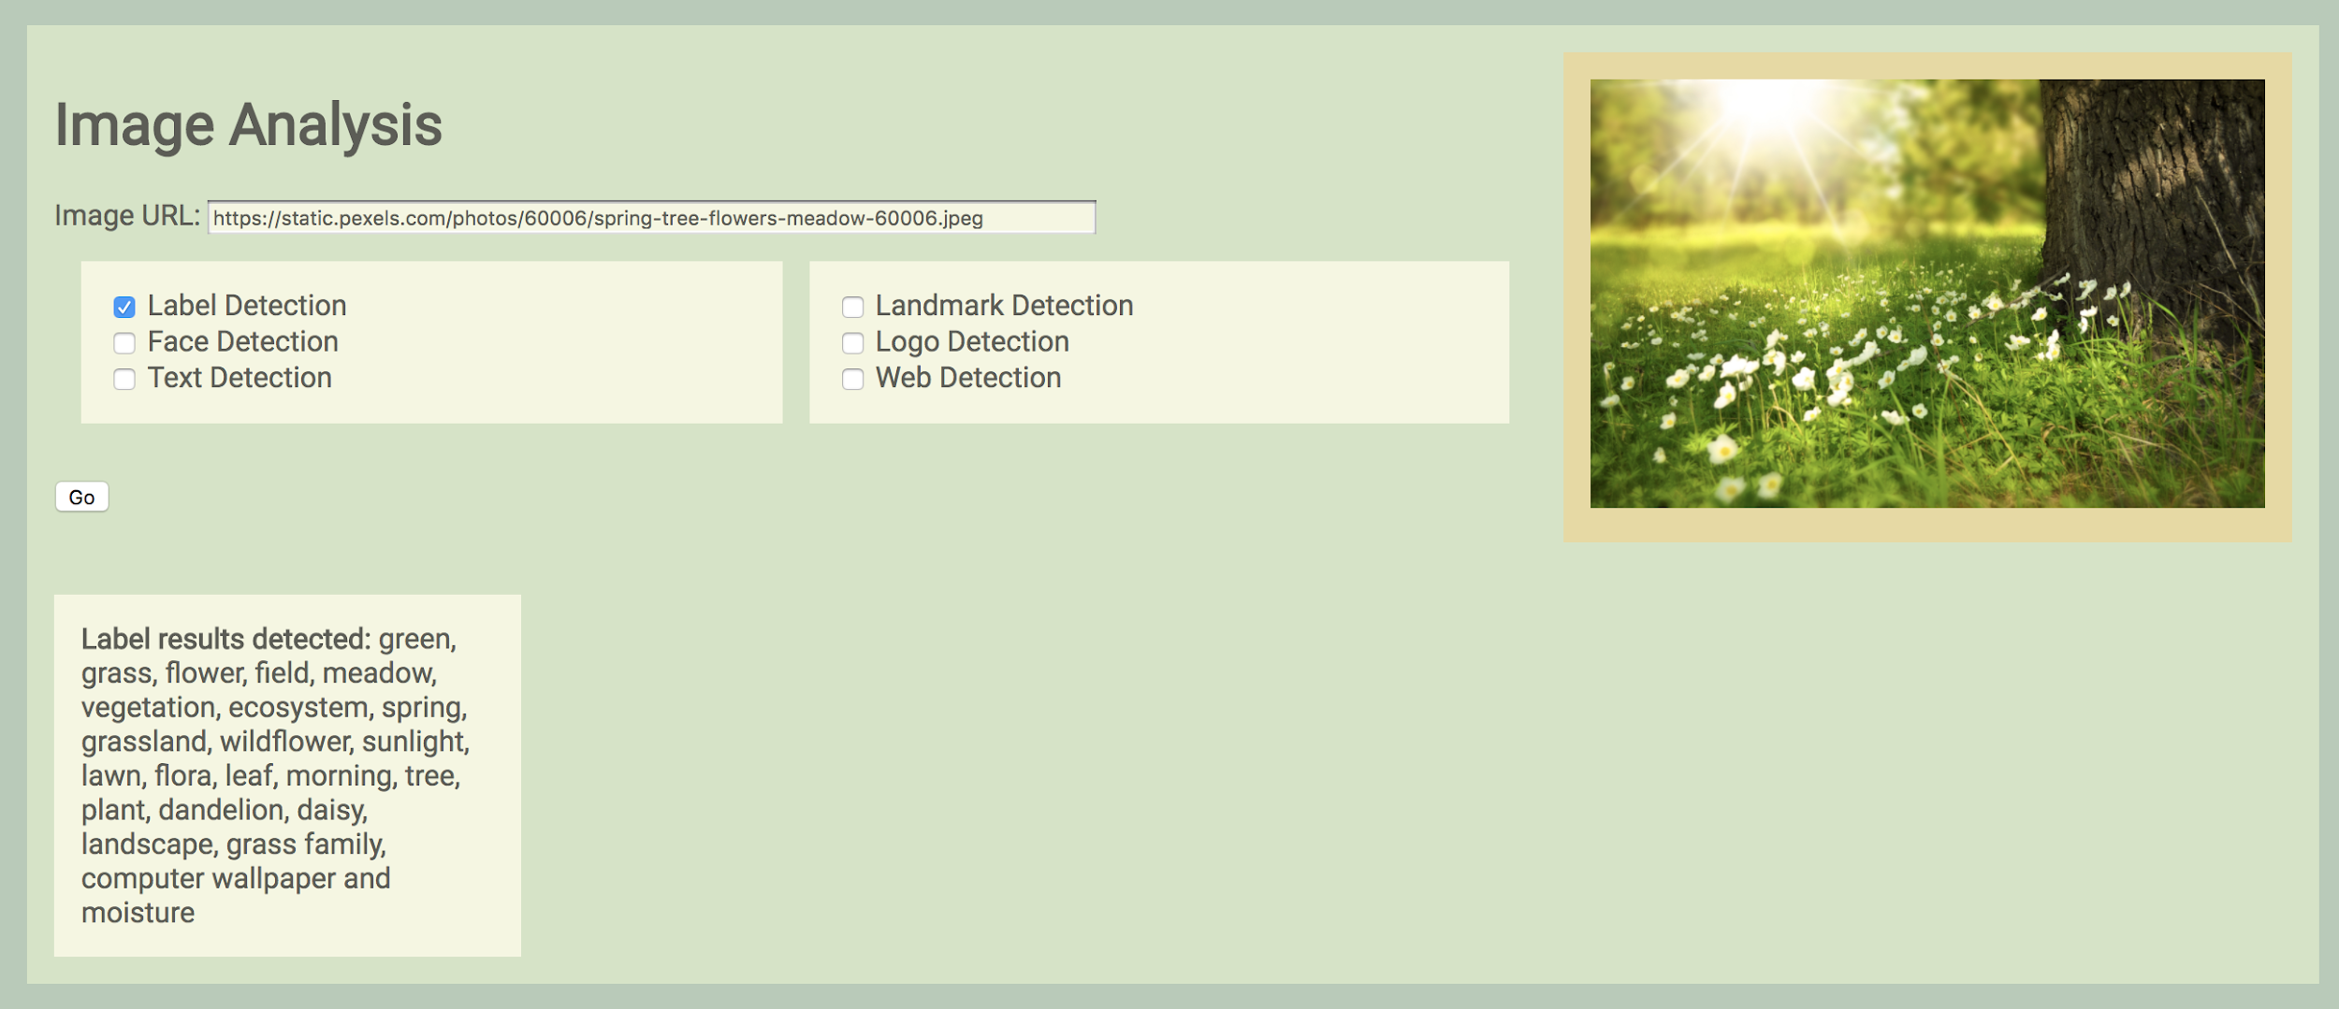
Example Image Labeling: Nature Scene
See results here
Notes:
Link to image used here:
https://static.pexels.com/photos/60006/spring-tree-flowers-meadow-60006.jpeg

Slide 71
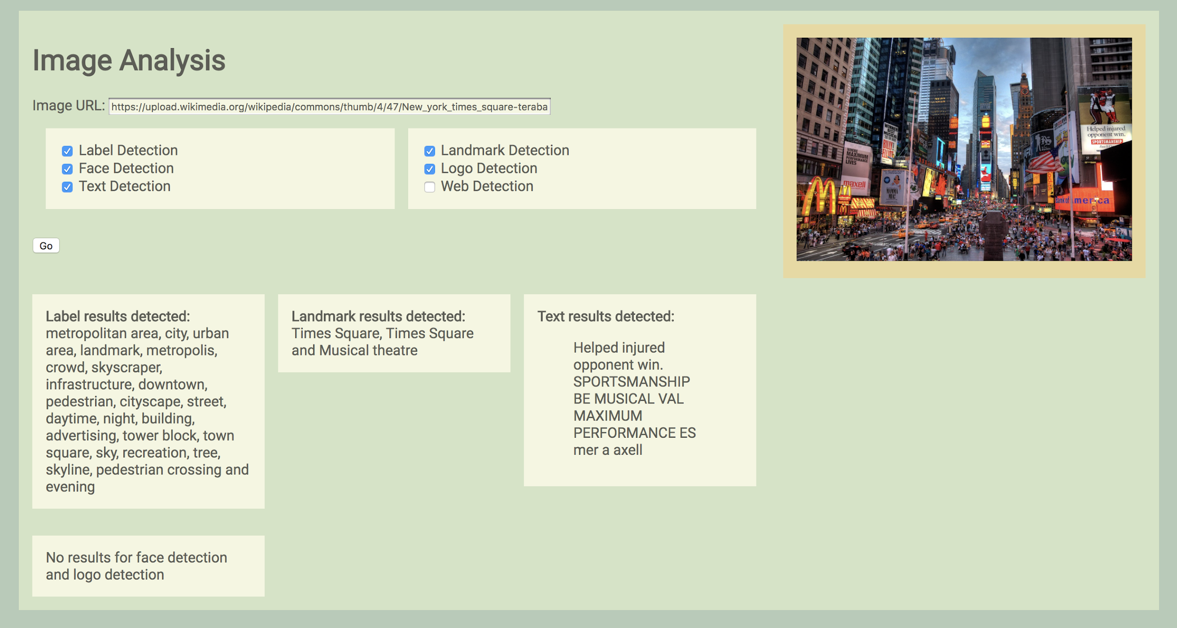
Another Example: Times Square, New York
Results are further categorized by label type (e.g., “landmark”)
Notes:
Link to image used here:
https://upload.wikimedia.org/wikipedia/commons/thumb/4/47/New_york_times_square-terabass.jpg/1200px-New_york_times_square-terabass.jpg

Slide 72

Try it Yourself
Test the app at:
https://get-started-with-ml-apis.appspot.com/

Slide 73
Starter Code Structure
Project +-- app.yaml +-- appengine_config.py +-- back-end.py +-- front-end/ | +-- main.html +-- main.css +-- main.js +-- lib/
Download a .zip of the starter code.

Slide 74
Starter Code Structure - app.yaml
Project +-- app.yaml +-- appengine_config.py +-- back-end.py +-- front-end/ | +-- main.html +-- main.css +-- main.js +-- lib/
The app’s settings are configured here.
App ID
Version
Handlers for each URL path

Slide 75
Starter Code Structure - appengine_config.py
Project +-- app.yaml +-- appengine_config.py +-- back-end.py +-- front-end/ | +-- main.html +-- main.css +-- main.js +-- lib/
Python module configuration, allowing users to specify values for constants and “hook” some functions for use.
appengine_config also imports useful libraries in lib/ (listed below).

Slide 76
Starter Code Structure - back-end.py
Project +-- app.yaml +-- appengine_config.py +-- back-end.py +-- front-end/ | +-- main.html +-- main.css +-- main.js +-- lib/
Logic and data-access layer of the app.
Calls to the Cloud Vision wrapper come from here, as do functions implementing result parsing and printing.

Slide 77
Starter Code Structure - front-end/
Project +-- app.yaml +-- appengine_config.py +-- back-end.py +-- front-end/ | +-- main.html +-- main.css +-- main.js +-- lib/
Presentation layer of the app.
The three files in this directory work together to construct the “front-end”:
HTML: content and structure of page
CSS: adds style
JS: gets elements, listens to actions

Slide 78
Starter Code Structure - lib/
Project +-- app.yaml +-- appengine_config.py +-- back-end.py +-- front-end/ | +-- main.html +-- main.css +-- main.js +-- lib/
Directory of libraries needed by our app (e.g. googleapiclient).
Import declaration is found in appengine_config.py

Slide 79
The Cloud Vision Wrapper
Built with Google Cloud Endpoints, it provides an API you can use in your app to call functions implemented by the Cloud Vision API:
detect_faces
detect_labels
detect_landmarks
detect_logos
detect_text
detect_properties
detect_web
detect_crop_hints
detect_document
These functions accept a link to an image on the Web.

Slide 80
Calling a Function from the Cloud Vision Wrapper
The functions in the API can be called from your code as follows:
request_url = wrapper_url + '/' + function_req_map[feature] + '?imageURL=' + uri + '&key=' + api_key request = urllib2.Request(request_url) response = urllib2.urlopen(request).read()
wrapper_url refers to the URL of the Cloud Vision Wrapper.
function_req_map[feature] is the name of the specific API you want to call (e.g., detectFaces).
uri is the URL of the image you want to classify.
api_key is the API key.
urllib2.Request constructs the request to the API.
urllib2.urlopen captures the response returned by the API.

Slide 81
Detect Functions in the Cloud Vision Wrapper
Each of the detect functions in the wrapper follows a similar pattern:
Check if the image at input url is null; if so, throw an exception.
Set up the Cloud Vision API client.
Read in provided input image.
Check for unsafe content in the image; if unsafe content is found, return without calling API detection functions.
Call the Cloud Vision API to detect labels using the client in step 2.
Extract labels from result object.
Return labels.

Slide 82
Project Ideas
Front-end: Modify the user interface (look-and-feel) part of the app, e.g.:
Change colors; move input field; change options’ display; restyle results page
Allow the user to upload multiple images at a time; return results in downloadable files (one for each photo)
Back-end: Modify calls to Vision wrapper, result parsing and printing, e.g.:
Change the formatting of Cloud Vision wrapper results for printing
Add recommendations to the user according to results. For example, if the user requests “Label Detection” and one of the labels is “city,” suggest they try “Landmark Detection” as well to get more specific labels.
Consult the Web App Student Guide for guidance while working on your project

Slide 83
Presenting our Apps
What changes did you make to the app?
What successes did you achieve?
What challenges did you face?
How did using an API simplify the process of building an image-recognition app?

Slide 85
Getting Started with Machine Learning
Session 1: Understanding Machine Learning
Notes:
Facilitator doc

Slide 86


Learning Objective
By the end of the session, you will have run a machine learning experiment to classify foods as pizza or not pizza
Not-Pizza
Pizza

Slide 87
Pair Work: Run an ML Experiment
Find a partner
Go to https://sliceofml.withgoogle.com/
Click "Let’s do this”

Slide 88
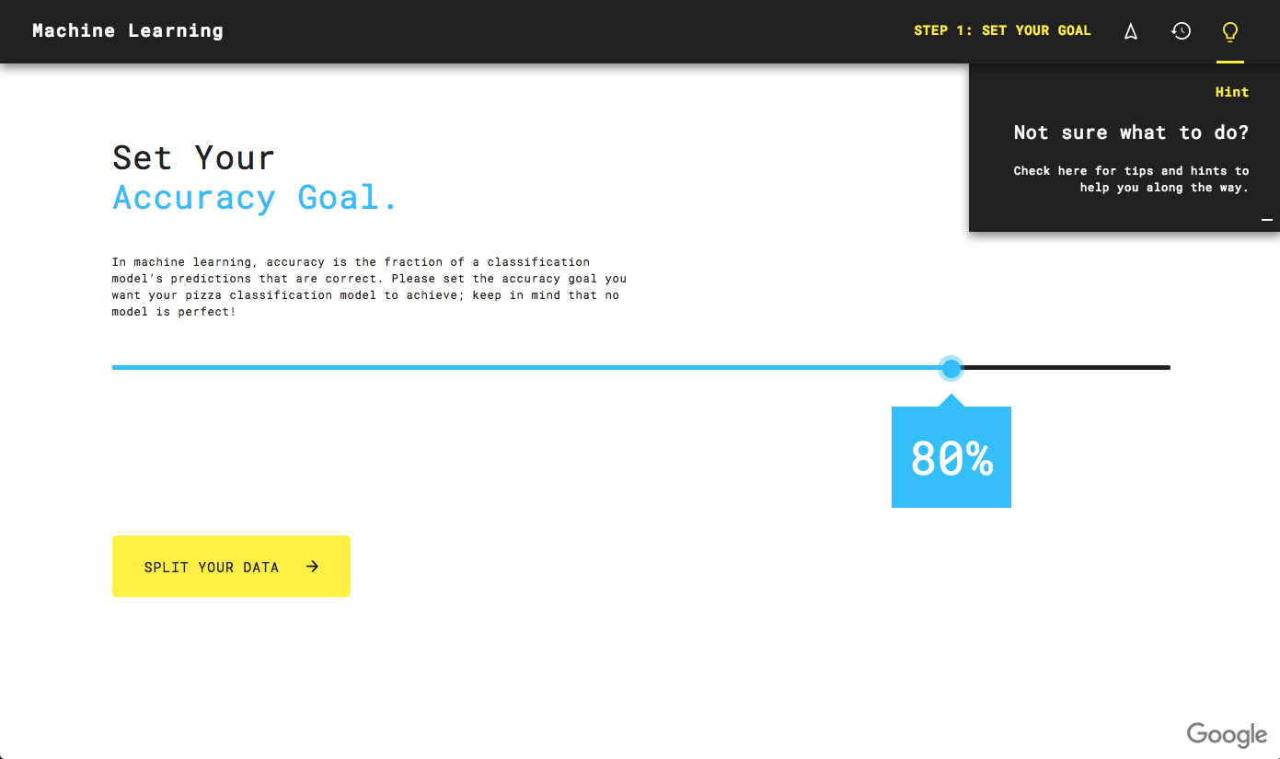
Pair Work: Set an Accuracy Goal

Slide 89
Pair Work: Run an ML Experiment
1
2
3
4
5
Set
Goal
Split
Data
Train
Model
Test
Model
Results

Slide 90
Debrief
Notes:
Facilitator doc

Slide 91
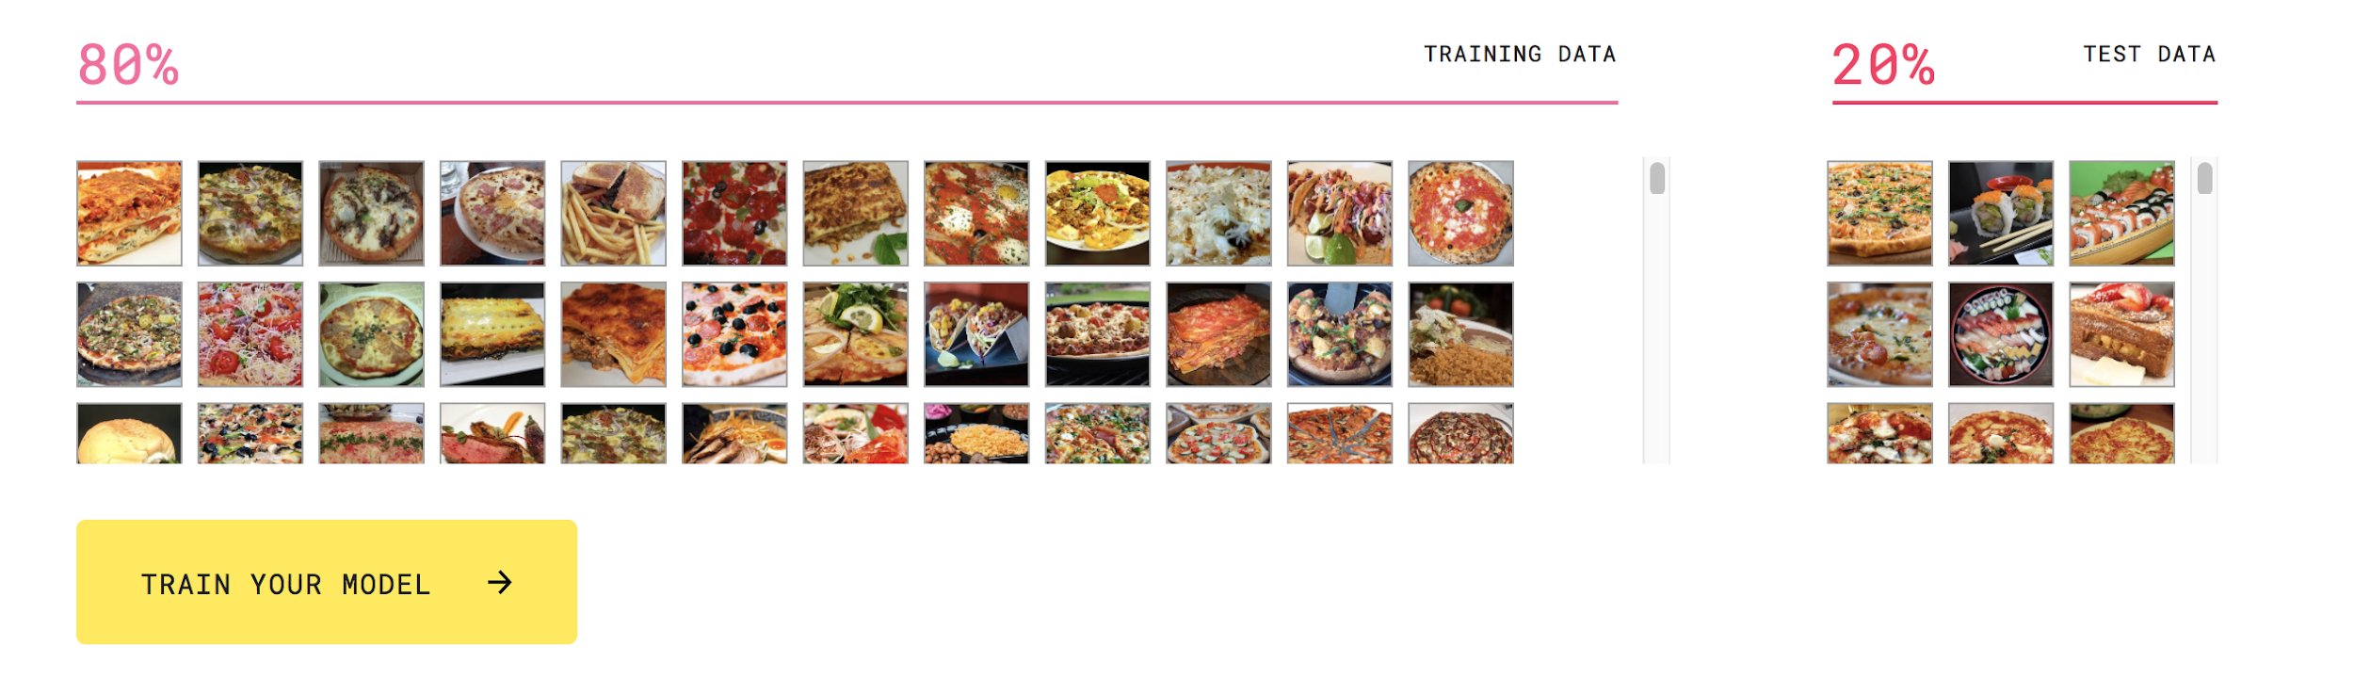
Debrief: Our First Experiment
Why divide data into training and testing sets? What’s the goal of each?

Slide 92
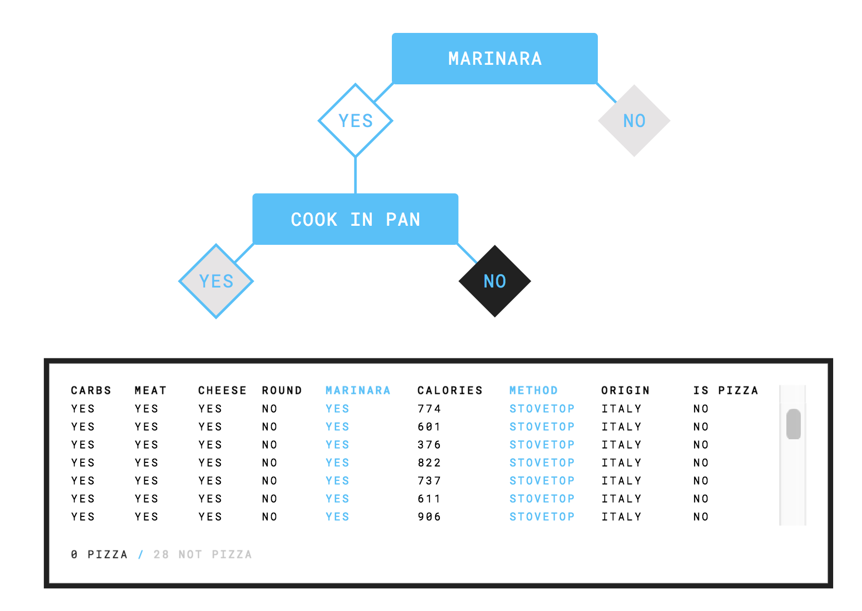
Debrief: Our First Experiment
How does the decision tree work?

Slide 93
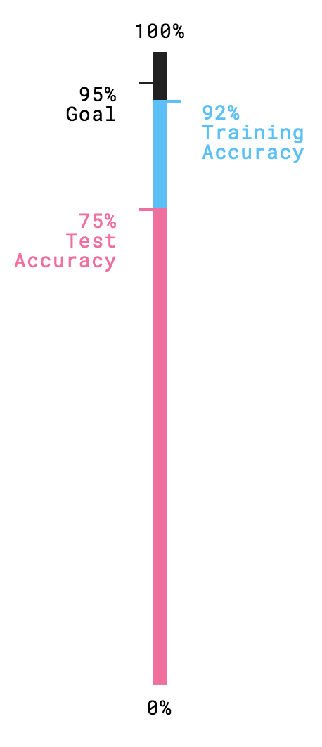
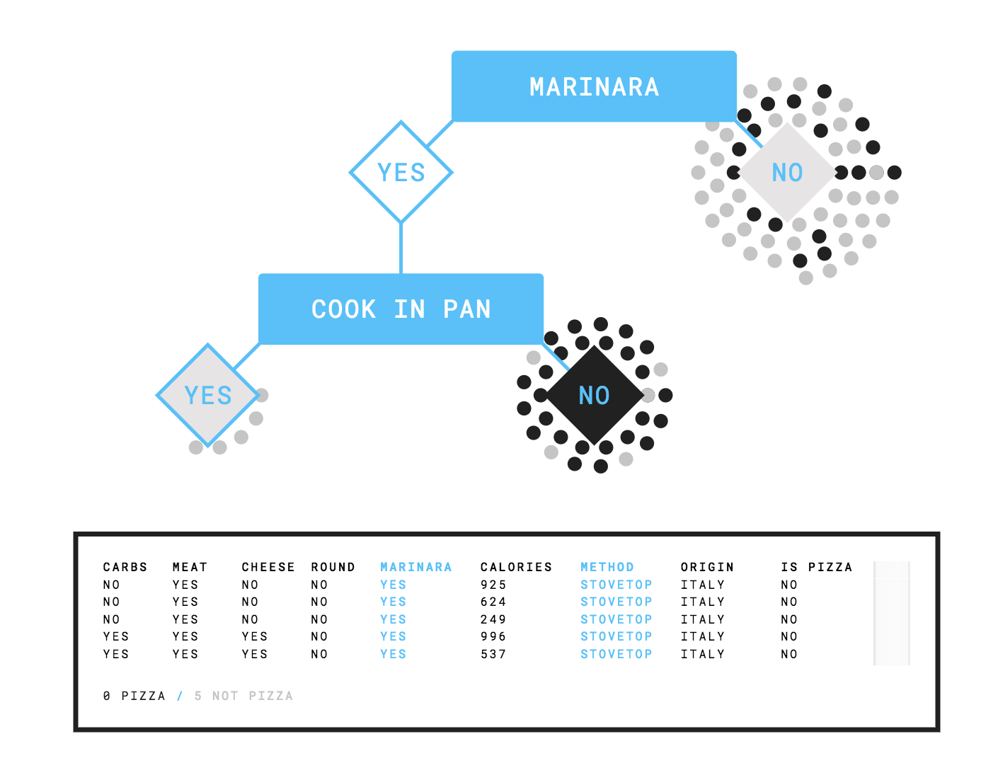
Debrief: Our First Experiment
Why might we have gotten different accuracy results on the training and testing data?

Slide 94
Debrief: Our First Experiment
1
2
3
4
Set
Goal
Split
Data
Train
Model
Test
Model
How might you refine the experiment to get your model's training and testing accuracy to be 90% or more?

Slide 95

Run More Experiments
1
2
3
4
5
Set
Goal
Split
Data
Train
Model
Test
Model
Results

Slide 96
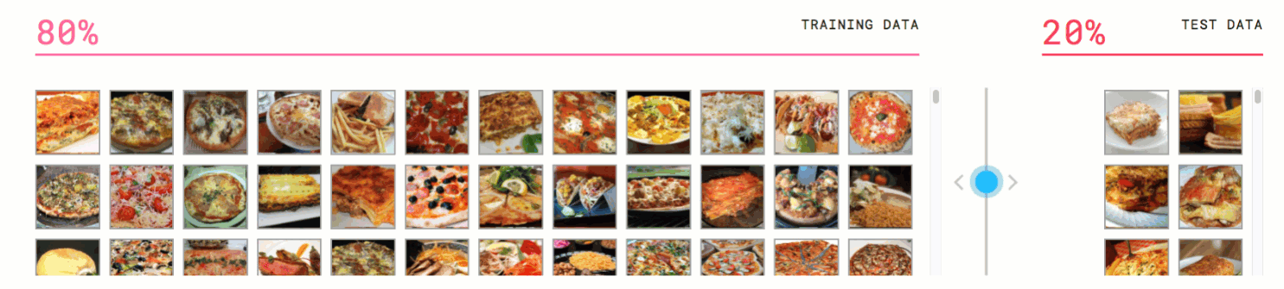
Run More Experiments
1
2
3
4
5
Set
Goal
Split
Data
Train
Model
Test
Model
Results

Slide 97
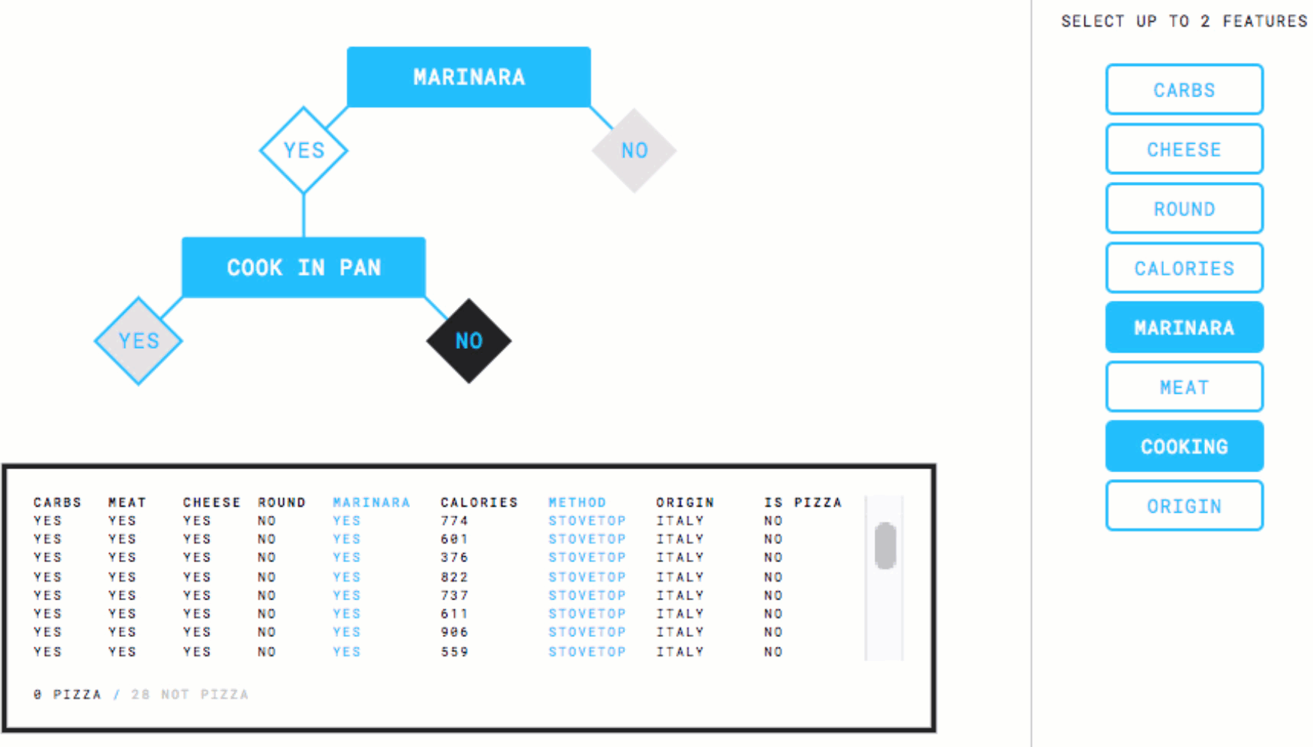
Run More Experiments
1
2
3
4
5
Set
Goal
Split
Data
Train
Model
Test
Model
Results

Slide 98
Run More Experiments
1
2
3
4
Set
Goal
Split
Data
Train
Model
Test
Model
How might you refine the experiment to get your model's training and testing accuracy to be 90% or more?

Slide 99
Debrief
Goal
No
Current
algorithms
achieve goal?
Yes
Data
Machine Learning System
Rule-based System

Slide 100
Debrief
Training Data
Test Data
Risk of overfitting
Poor quality model

Slide 101
Debrief

Slide 102
Getting Started with Machine Learning

